Slide 1
Ensuring a Robust NIH Clinical Trial Enterprise
Debara L. Tucci MD, MS, MBA
NIH Clinical Trial Stewardship Task Force,
Co-Chaired with Lyric Jorgensen, PhD
With contributions by Carrie Wolinetz, PhD

Slide 2
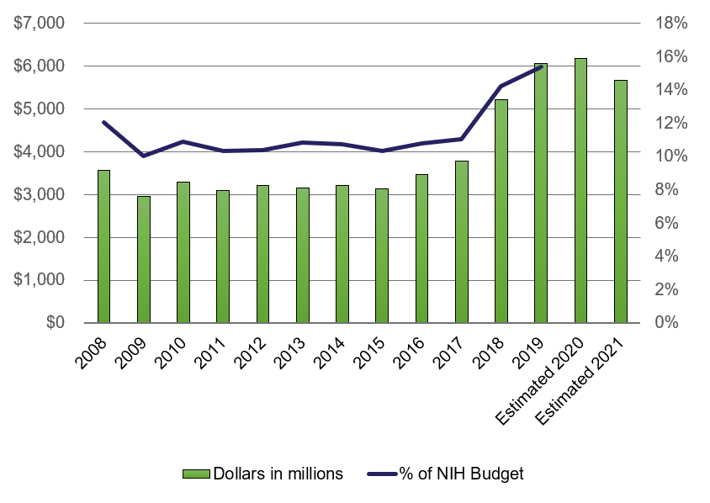
Vital Importance of Clinical Trial Stewardship
NIH committed to responsible stewardship
$18B investment in clinical research; over $6B supports clinical trials
Ensuring appropriate management, oversight and efficiency of CT enterprise essential to NIH mission
Generate best possible evidence to support public health, clinical care
COVID-19 highlighted need for further efficiency and inclusiveness in CTs
NIH “Clinical Trials and Supportive Activities”

Slide 3
Key Principles of CT Oversight and Conduct
Protect and support participants
Ensure that research is meaningful to participants and public
Ensure effective research/trial design and management to maximize benefit to public and conserve NIH resources
Promote transparency, trust and communication of all clinical research conduct and results

Slide 4
Characteristics of NIH-funded CTs; Trends over time in CT.gov registered studies, 2005 – 2023 (M. Lauer)
290,495 trials registered
NIH funded 7%
Industry funded 33%
Other (institutions, private foundations) funded 60%
Most trials conducted by all sponsors are small and single-center
Change in NIH portfolio over time: fewer treatment, drug trials; more prevention, behavioral trials
Large number of grant mechanisms support clinical trials (R, U, P, K and others), networks
U grants (cooperative agreement) more likely to be classified as a ‘Phase’ (1 or 3) trial, to be multi-center and to focus on drugs/biologics
R01 mechanism more likely to fund basic science, prevention, health services research, and to test behavioral interventions
Some trials funded through established networks, contracts, OTAs

Slide 5
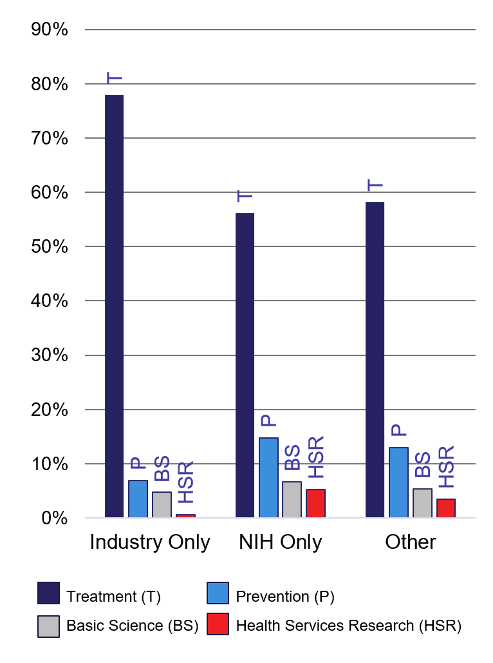
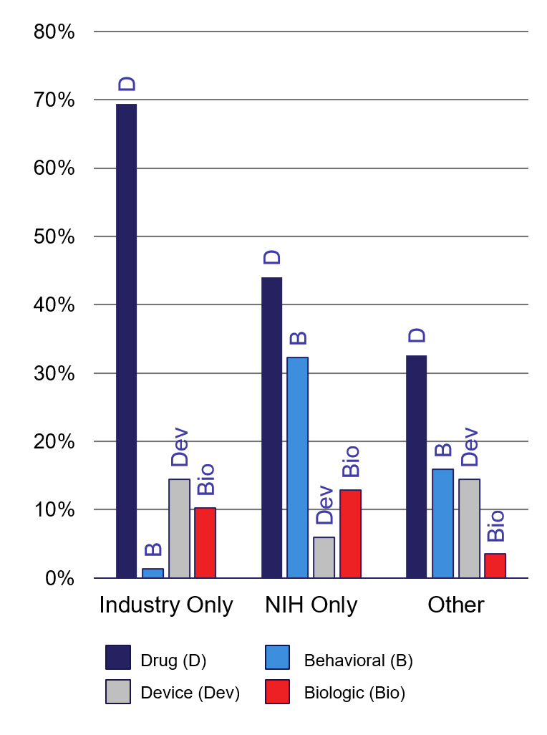
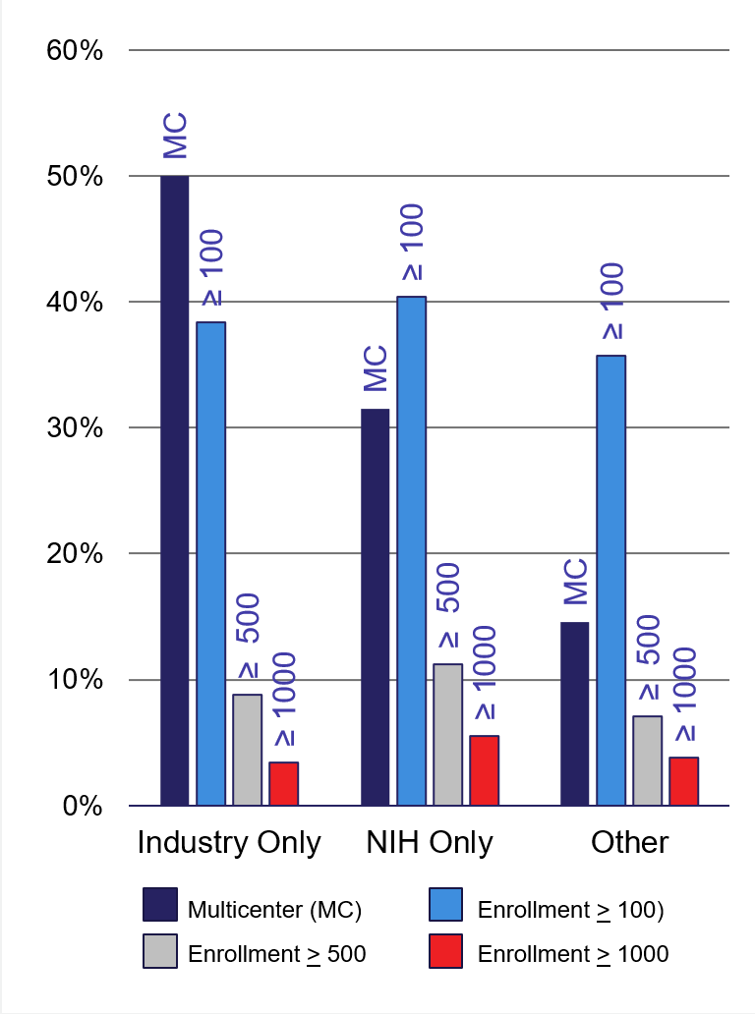
Trial Characteristics According to Sponsor
Source: Michael Lauer, MD (NIH OER)
Primary Purpose
Type of Intervention
Enrollment

Slide 6
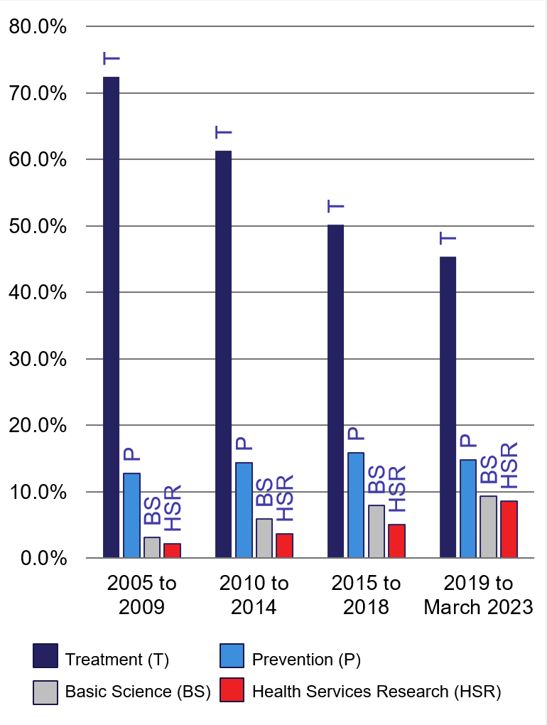
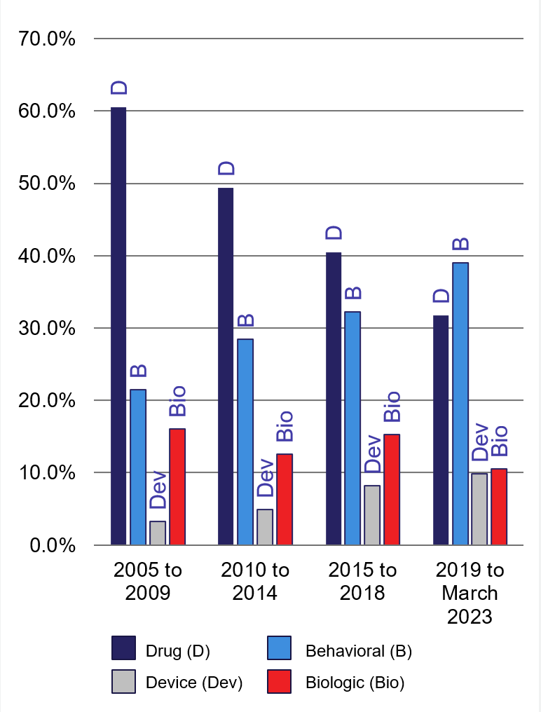
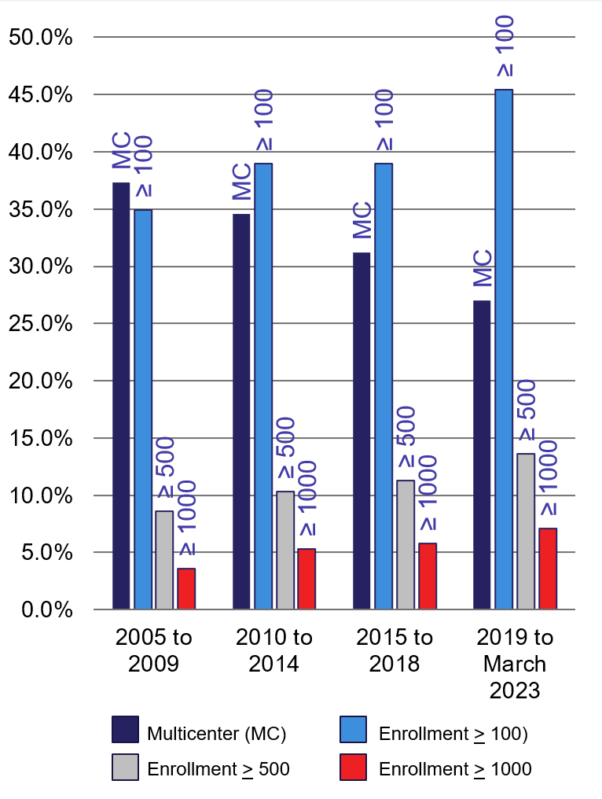
NIH Trial Characteristics According to Year of Registration
Source: Michael Lauer, MD (NIH OER)
Primary Purpose
Type of Intervention
Enrollment

Slide 7
Clinical Trial Stewardship Task Force, 2021 - 2022
Background
Periodic review of NIH clinical research/clinical trial processes to evaluate and adjust policies and procedures to optimally support our portfolio, for both extramural and intramural research
Last reviewed by 2014 Task Force; during 2016 – 2020, NIH developed resources, tools, dedicated funding announcements, and training for NIH staff, peer reviewers and investigators to support implementation
New Task Force convened with wide representation across NIH; Charge: to evaluate -
Progress of prior policy reforms (5 year)
Efficiency, interoperability and oversight of current CT network operations and capabilities of operations to support public health needs
Implementation of NIH inclusion policies & opportunities to further enhance diversity and inclusion in clinical research

Slide 8
Task Force Membership
Debara Tucci, NIDCD (co-chair)
Lyric Jorgenson, OD (co-chair)
Michelle Culp, OD (staff lead)
Martha Barnes, NIEHS
Robin Boineau, NICCH
Noni Byrnes, CSR
Michael Chiang, NEI
Janie Clayton, OD
Lindsey Criswell, NIAMS
Jim Doroshow, NCI
Rena D’Souza, NIDCR
Greg Germino, NIDDK
Michael Gottesman, OD
Jonathan Green, OD
Michael Kurilla, NCATS
Cliff Lane, NIAID
Mike Lauer, OD
Janice Lee, NIDCR, OD
Raye Litten, NIAAA
Teri Manolio, NHGRI
Anna Ordóñez, NIMH
Amy Patterson, NHLBI
Sergei Romashkan, NIA
Carmen Rosa, NIDA
Caroline Signore, NICHD
Monica Webb Hooper, NIMHD
Becky Williams, NLM
Clinton Wright, NINDS
Shannon Zenk, NINR

Slide 9
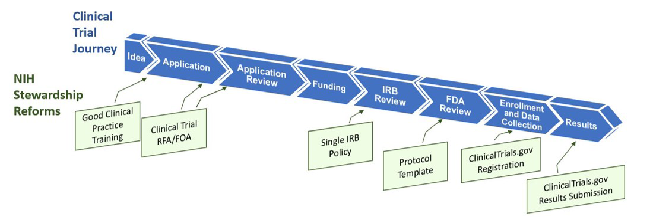
2016 Reforms Target the Clinical Trial Lifecycle
“NIH has launched a multifaceted effort to improve the quality and efficiency of clinical trials … These initiatives will reengineer the process by which clinical investigators develop ideas for new trials, how NIH reviews and selects clinical trials for support and oversees the progress of the research, and how results and aggregate data are shared broadly and rapidly."
Hudson, Lauer, & Collins, JAMA 2016
https://nexus.od.nih.gov/all/2016/09/16/clinical-trials-stewardship-and-transparency/

Slide 10
Outline
Review six consolidated recommendations of the Task Force
Challenges and needs identified
Specific recommendations
Summary of challenges across NIH
Discussion of NIH vision and unique role in national clinical research and clinical trial ecosystem

Slide 11
Develop strategies to coordinate and leverage NIH investment in clinical trial infrastructure
Challenges and Needs Identified
Define and track clinical trial investments, and associated infrastructure
Identify best funding mechanisms for support of clinical trials
Identify and strategically engage with potential partners (per ACTIV):
Currently no NIH-wide definition of ‘clinical trial network’, and no unique identifiers of CTNs or associated CTs
Once defined, identify CTNs NIH-wide, including purpose, structure, capabilities, funding mechanism, ‘best practices’
Understanding characteristics/ capabilities could inform policies that lead to enhanced CT efficiency and adaptability (ongoing and during PHE)
Knowledge of existing NIH networks, resources and infrastructure could facilitate partnerships among ICOs
Funding mechanisms used: grants, contracts, Other Transaction Authorities (OTAs)
Varies by IC based on experience and staff preference, but could possibly be leveraged more strategically
FDA, PCORI/PCORnet, Frederick National Laboratory, others

Slide 12
Maximize effectiveness and efficiency of clinical trial oversight, and facilitate and define trial ‘success’
Challenges and Needs Identified
NIH does not have standard metrics to monitor clinical trial conduct and progress
Are there metrics and milestones that help predict successful completion of a clinical trial?
ICOs have very different resources and processes for monitoring clinical trials
NIH staff are often the experts in CT design and conduct, and support PIs who are the SMEs
Clinical Trial Operations Working Group (CTOW) recently spearheaded documentation of SOPs
Need for established metrics to capture: enrollment targets and rates (including those related to race/ethnicity, sex/gender, and age); IRB approval, primary endpoint reached, and others determined to be of importance
Ongoing and consistent monitoring facilitates progress and accountability
Success of a trial can be identified in a number of ways: meet enrollment target, meet enrollment target on time, prove/disprove hypothesis, publication, implementation in clinical practice to improve health
Process to inform continuous review and ‘stopping rules’ for underperforming trials, to maximize responsible use of NIH and participant resources (time, money, trust)
NIH staff burden is significant: create more efficient systems to support staff NIH-wide, decrease burden

Slide 13
Establish consistent, high quality clinical trial review processes across NIH
Challenges and Needs Identified
Extramural review of Clinical Trial–specific FOAs
Other clinical trials funding mechanisms:
Need to ensure consistency of review across all mechanisms used at NIH
Acknowledgement that review is multi-layered:
2023 – NIH Steering Committee and leadership approved the integration of rigorous clinical trial evaluation into the simplified review framework for RPGs
Intramural research
Contracts and OTAs
Research conducted through established/funded networks
both scientific and operational/feasibility review

Slide 14
Establish policies that elevate diversity, equity, and inclusion in the recruitment and retention of participants in clinical research
Challenges and Needs Identified
Improve monitoring of diverse participants in research
Increase opportunities to enroll diverse populations by facilitating partnerships and engagement with diverse and underrepresented communities
Increase equity
Increase interoperability of NIH data systems to improve access and usability of inclusion-related data
Enhance training for staff to improve quality of review of inclusion plans
Consider actions to improve accountability for meeting enrollment goals
Establish trust within communities based on long-standing engagement
Additional data such as socioeconomic status, disaggregated race/ethnicity data beyond that required by OMB

Slide 15
Promote participants as partners in clinical research
Challenges and Needs Identified
Declining trust in research/ longstanding mistrust in some communities
Bi-directional engagement essential to foster transparency and trust
Build by-in at early stage will improve later implementation and dissemination of scientific discoveries in these communities
Need to develop NIH-wide framework to guide and support all ICOs in engaging partners in research
Craft a unified and public vision promoting community engagement as critical to the clinical research enterprise
Engage participants in development of optimal strategies for planning, implementation and dissemination of research studies

Slide 16
Embrace and implement new research methodologies, strategies and resources
Challenges and Needs Identified
Augment pragmatic clinical trials in real-world settings
Pursue novel and responsible approaches for utilizing diverse datasets
Improve generalizability and strategies for implementation and dissemination for greatest impact on public health
Facilitate convergence of clinical research and clinical practice
Workforce and career development
NIH working toward a future of interoperability and maximum utility of data from a variety of sources
Collect, store, use data more effectively
Maximize utility & integration of Electronic Health Record (EHR) data in clinical research
Individual-level participant data (IPD) – define and promote best practices
Address challenges of data use: privacy, proprietary concerns, data standards and interoperability, other

Slide 17
Next Steps for Consideration and Discussion (1)
NIH-wide vision for clinical trials
Continued consideration of needs, priorities for investments
Develop new resources and programs to achieve NIH strategic vision
Leverage strategic partnerships with other agencies and entities
Effectively partner with the extramural community to advance clinical care and public health

Slide 18
Next Steps for Consideration and Discussion (2)
Develop mechanisms for a
‘Learning Clinical Research Ecosystem’
Maximize ability of all ICOs and programs to learn from each other
Numerous examples of lessons learned and innovative practices that could benefit all ICOs if widely disseminated
Help smaller ICOs realize their vision for impactful clinical trials
Minimize organizational risk by fully leveraging current expertise and resources and maintaining NIH-wide perspective

Slide 19
‘Big Picture’ Questions for Discussion
What should the role of NIH be, as a major public research funder, in the broader clinical research ecosystem?
How should NIH best address the urgent need for increased diversity, equity and inclusion in clinical research?
Clinical research is increasingly interdisciplinary and multi-site – how should we be thinking about new models for working across sectors to increase impactful translation?

