Slide 1
Director’s Update
126th Advisory Committee to the Director
June 8, 2023
Lawrence A. Tabak, DDS, PhD Acting Director, NIH Department of Health and Human Services
Presentation contains speaker notes

Slide 2
Topics for Today
NIH Leadership Changes
Awards
SRLM Groundbreaking
NIH Virtual Tour
DEIA Strategic Plan
UNITE Update
Simplifying Review Criteria
COVID Updates
Initiatives updates
Budget and Legislative Updates
Transitions

Slide 3
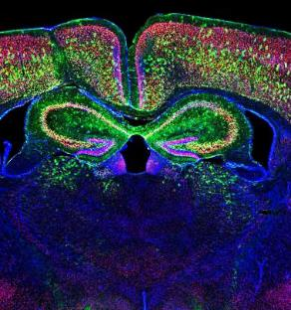
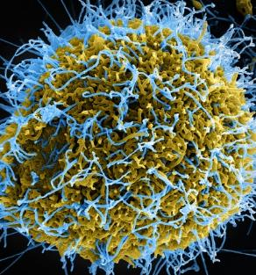
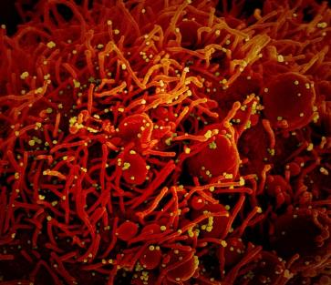
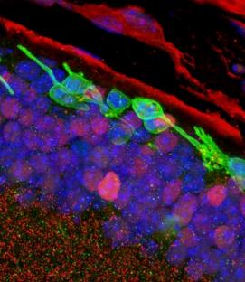
Topics for Today
NIH Leadership Changes
NIH Leadership Changes
Awards
SRLM Groundbreaking
NIH Virtual Tour
DEIA Strategic Plan
UNITE Update
Simplifying Review Criteria
COVID Updates
Initiatives updates
Budget and Legislative Updates
Transitions

Slide 4
Nominee for NIH Director
Monica Bertagnolli, MD

Slide 5
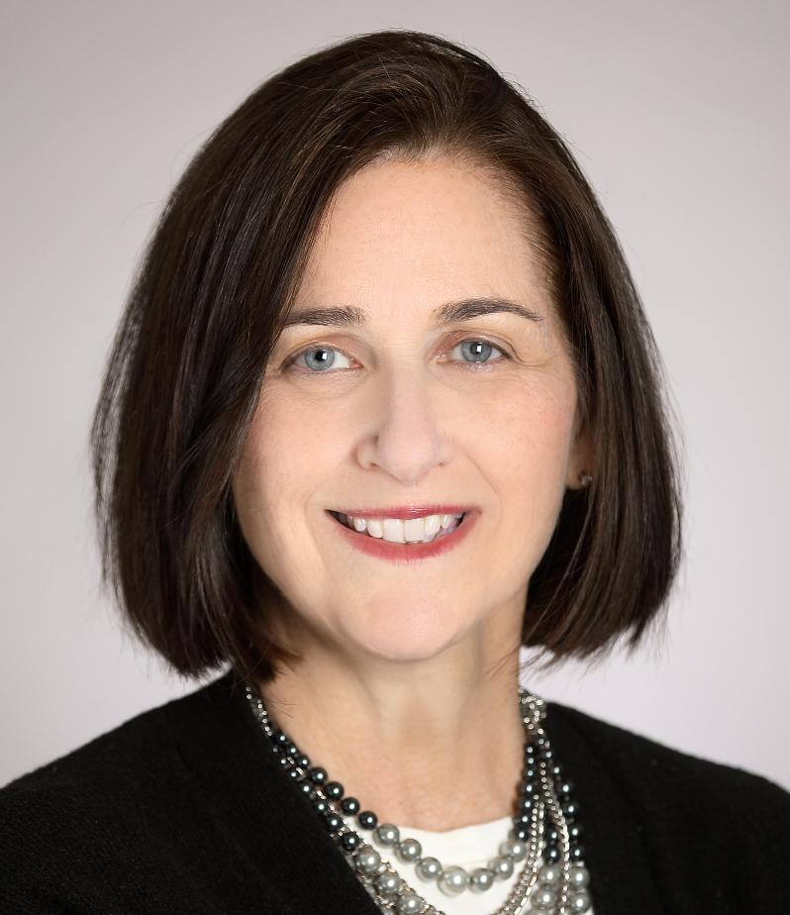
Acting Associate Director for Legislative Policy and Analysis
Lauren Higgins

Slide 6
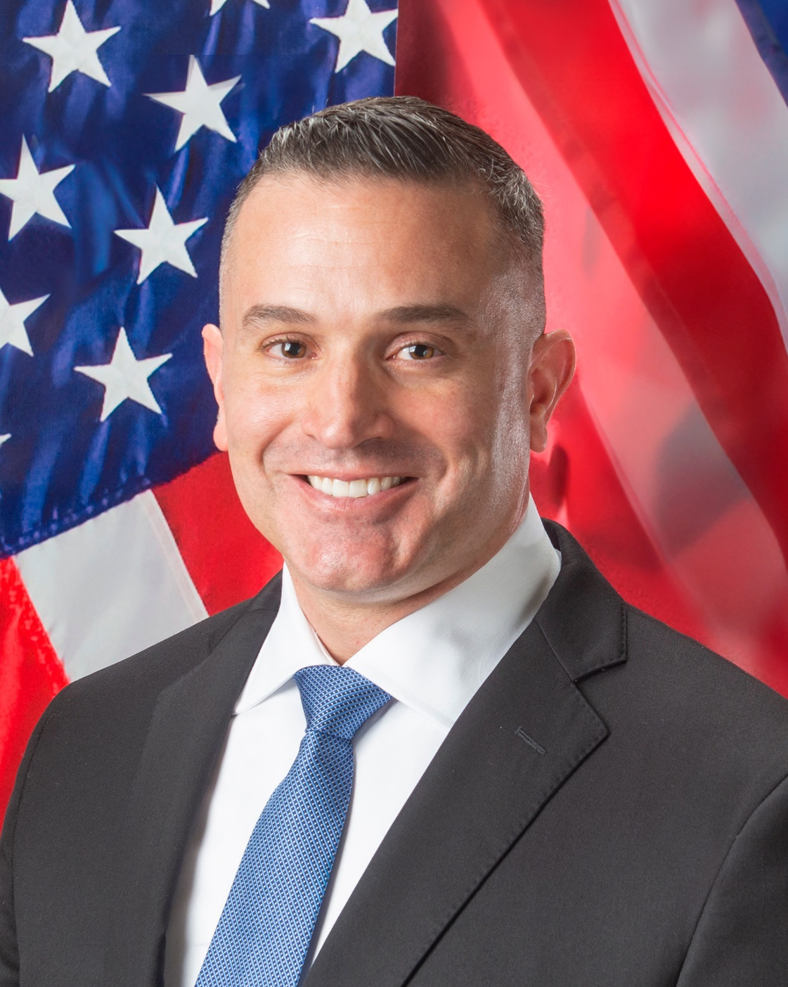
Director, Office of Dietary Supplements
Stefan M. Pasiakos, PhD, FACSM

Slide 7
Acting Associate Director for AIDS Research
Bill G. Kapogiannis, MD

Slide 8
Acting Associate Director for Behavioral and Social Sciences Research
Wendy Smith, PhD

Slide 9
Director, NIH Tribal Health Research Office (THRO)
Karina L. Walters, PhD, MSW

Slide 10
Topics for Today
Awards
NIH Leadership Changes
Awards
SRLM Groundbreaking
NIH Virtual Tour
DEIA Strategic Plan
UNITE Update
Simplifying Review Criteria
COVID Updates
Initiatives updates
Budget and Legislative Updates
Transitions

Slide 11
Service to America Awards 2023 Finalists
Arang Rhie, PhD
Adam Phillippy, PhD
Sergey Koren, PhD
and the Telomere-to-Telomere Team

Slide 12
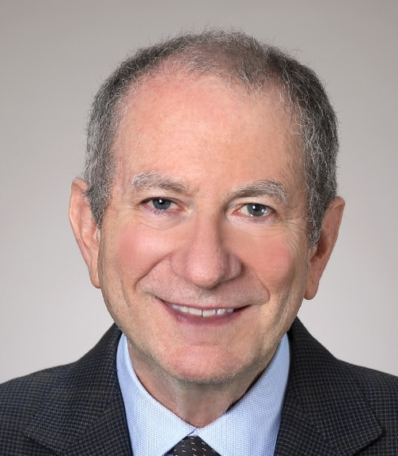
Service to America Awards 2023 Paul A. Volcker Career Achievement Finalist
Eric J "Rocky" Feuer, PhD

Slide 13
Topics for Today
SRLM Groundbreaking
NIH Leadership Changes
Awards
SRLM Groundbreaking
NIH Virtual Tour
DEIA Strategic Plan
UNITE Update
Simplifying Review Criteria
COVID Updates
Initiatives updates
Budget and Legislative Updates
Transitions

Slide 14
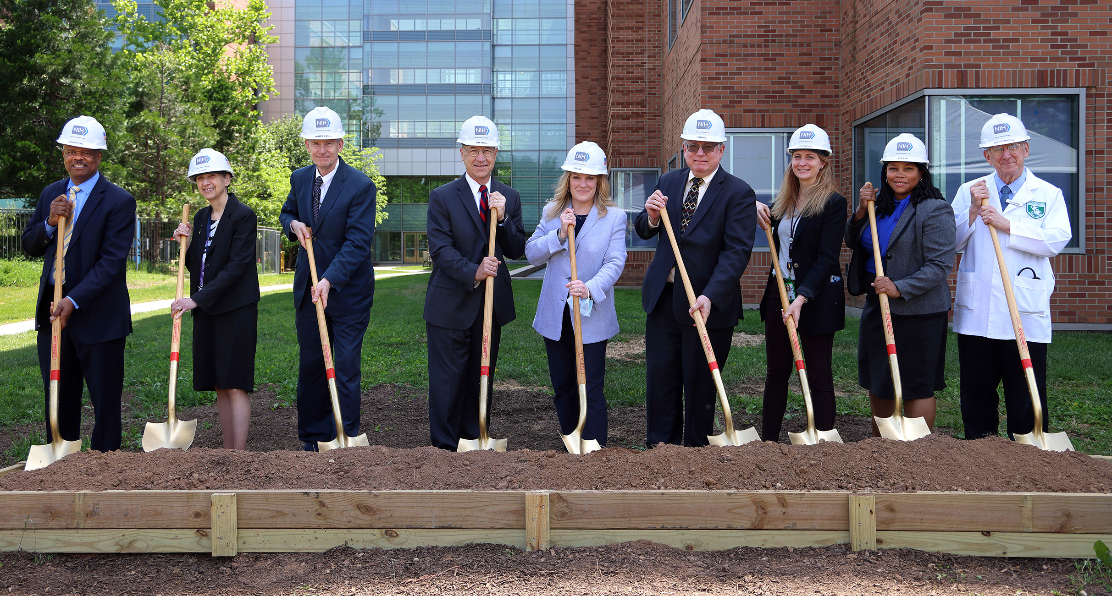
Surgery, Radiology and Laboratory Medicine Wing of the Clinical Center

Slide 15
Topics for Today
NIH Virtual Tour
NIH Leadership Changes
Awards
SRLM Groundbreaking
NIH Virtual Tour
DEIA Strategic Plan
UNITE Update
Simplifying Review Criteria
COVID Updates
Initiatives updates
Budget and Legislative Updates
Transitions

Slide 16
NIH Virtual Tour

Slide 17
Topics for Today
DEIA Strategic Plan
NIH Leadership Changes
Awards
SRLM Groundbreaking
NIH Virtual Tour
DEIA Strategic Plan
UNITE Update
Simplifying Review Criteria
COVID Updates
Initiatives updates
Budget and Legislative Updates
Transitions

Slide 18
New NIH DEIA Strategic Plan
Development: Since 2021 by an NIH-wide Working Group with public & NIH input; reviewed & approved by NIH leadership. Released March 20, 2023.
Scope: FY 2023-2027. Articulates vision for integrating DEIA across all NIH activities.
Organization: Three priority areas (objectives) with common approaches (crosscutting themes)
Vision: NIH workforce and research priorities will reflect our nation’s diversity, welcome all people, and advance the NIH mission

Slide 19
Topics for Today
UNITE Update
NIH Leadership Changes
Awards
SRLM Groundbreaking
NIH Virtual Tour
DEIA Strategic Plan
UNITE Update
Simplifying Review Criteria
COVID Updates
Initiatives updates
Budget and Legislative Updates
Transitions

Slide 20
ComPASS
Program duration: 10 years
Planned budget: ~ $153M over a 5-year period
OTA-22-007 (OTA)
Up to 25 awards, FY23
Community-Led, Health Equity Structural Interventions (CHESIs)
RFA-RM-23-012 (U2C)
Up to 5 awards, FY24
Health Equity Research Hubs (Hubs)
RFA-RM-23-001 (U24)
1 award, FY23
ComPASS Coordination Center (CCC)

Slide 21
Recently Enhanced/Released NOFOs
Science Education Partnership Awards (SEPA) – 17 ICOs
Research With Activities Related to Diversity (ReWARD) (PAR-23-122)
Instrumentation Grant Program for Resource-Limited Institutions (S10 - Clinical Trial Not Allowed) (PAR-23-138)
STrengthening Research Opportunities for NIH Grants (STRONG): Structured Institutional Needs Assessment and Action Plan Development for Resource Limited Institutions (RLIs) (PAR-23-144)

Slide 22
NIH INSTITUTIONAL EXCELLENCE IN DEIA PRIZE COMPETITION
$1M prize competition administered by COSWD and cosponsored by all 24 NIH funding ICs – up to 10 awards, of which up to 5 for Resource - limited Institutions
Challenge Goals
Recognize and reward institutions that have identified gaps in DEIA and designed, implemented, and evaluated interventions to address them to improve in DEIA within their faculty, postdoctoral scholars, and student bodies.
Identify effective practices for enhancing DEIA within faculty, postdoctoral scholars, and student bodies that are feasible and can be disseminated for adoption by other institutions.

Slide 23
NIH INSTITUTIONAL EXCELLENCE IN DEIA PRIZE COMPETITION
Key Dates
Prize launch: April 4, 2023
FAQ webinar: May 17, 2023
Entry period ends: September 26, 2023
Winners announced: December 2023
Visit the nihdeiaprize.org to review the eligibility and participation rules and to submit a written entry.

Slide 24
New UNITE Reports
RFI Report
External Listening Session Report
nih.gov/ending-structural-racism

Slide 25
Topics for Today
Simplifying Review Criteria
NIH Leadership Changes
Awards
SRLM Groundbreaking
NIH Virtual Tour
DEIA Strategic Plan
UNITE Update
Simplifying Review Criteria
COVID Updates
Initiatives updates
Budget and Legislative Updates
Transitions

Slide 26
Simplified Review Framework for RPGs
Goal: To facilitate the identification of the strongest, potentially highest-impact research
Reorganization of review criteria into three factors. All affect overall impact score.
Factor 1: Importance of the Research (Significance, Innovation) - scored 1-9
Factor 2: Rigor and Feasibility (Approach) - scored 1-9
Factor 3: Expertise and Resources (Investigators, Environment) - rated as appropriate or gaps identified
Most Additional Review Considerations (no bearing on overall impact) removed from first-level peer review.
RFI closed in March with >800 responses (~780 individuals, 30 scientific societies, 23 academic institutions):
Majority were very supportive - not surprising; recommendations developed with significant input from the extramural scientific community
Minority felt that Factor 3 should be scored; smaller minority suggested blinded reviews
Most called for strong training resources to socialize the change for reviewers, chairs, and staff
Next steps? Trans-NIH implementation committee with multidimensional expertise in peer review, reviewer training, staff training, eRA systems, communications, policy – will consider RFI input, develop roll-out strategy

Slide 27
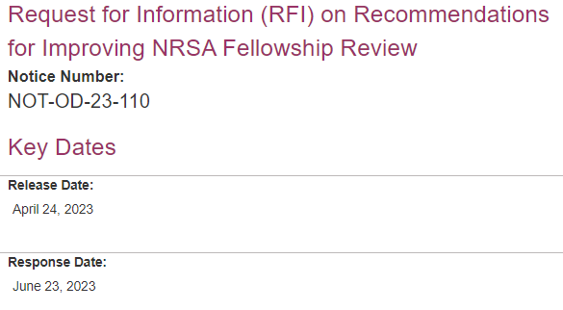
Simplifying Review: NRSA Fellowships
Goal: To facilitate the mission of scientific peer review- identify highly promising research scientists of the future
Background: Persistent concerns that NRSA fellowship review disadvantages some highly-qualified, promising applicants. Concerns are supported by data analysis of 6K fellowship applications:
The majority of fellowship applications are submitted by a small number of institutions and applications from those institutions do better in review
Review outcomes for fellowships improve as the rank of the sponsor increases
Details and data: https://public.csr.nih.gov/sites/default/files/2022-11/CSRAC_Fellowship_review_WG_report_September_2022_final.pdf
Major Recommendations
Revise the review criteria
Revise the application for alignment with the criteria
RFI open through June 23, 2023. Details and RFI submission at: https://grants.nih.gov/policy/peer/improving-nrsa-fellowship

Slide 28
Topics for Today
COVID Updates
NIH Leadership Changes
Awards
SRLM Groundbreaking
NIH Virtual Tour
DEIA Strategic Plan
UNITE Update
Simplifying Review Criteria
COVID Updates
Initiatives Updates
Budget and Legislative Updates
Transitions

Slide 29
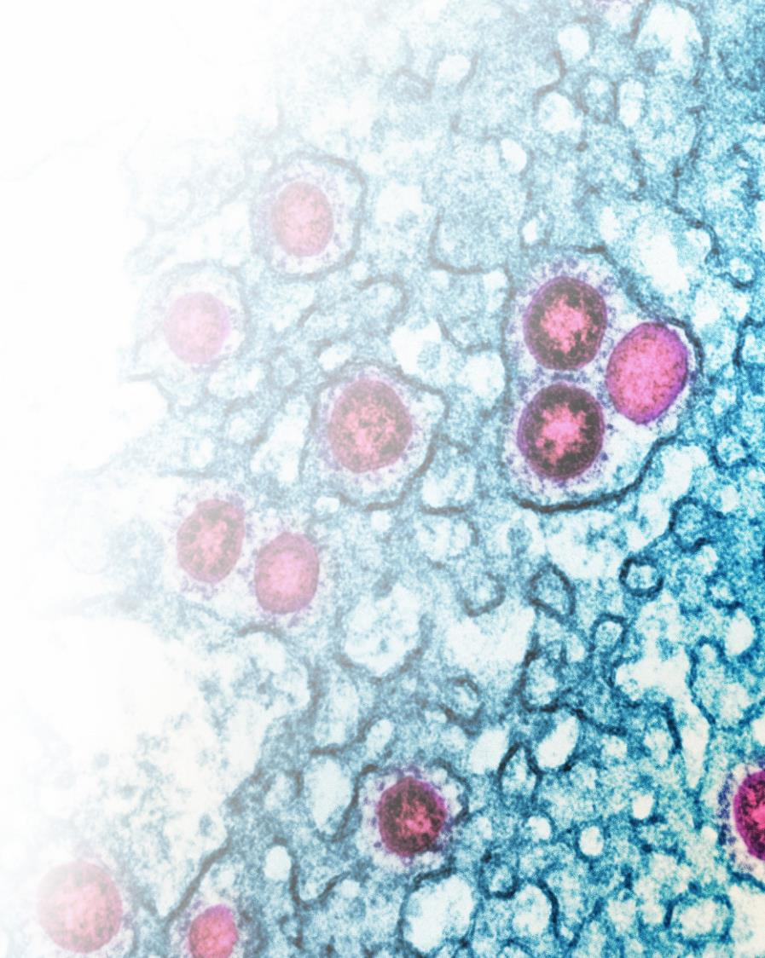
COVID-19 Pandemic: NIH-Wide Review of Lessons Learned
INNOVATIVE SCIENTIFIC COLLABORATIONS
WORKFORCE
OPERATIONS
INFRASTRUCTURE
COMMUNICATIONS
Safety, Adaptability, Resources
Ensure health, safety and welfare of staff
Manage burnout
Prepare qualified people at all levels to support timely decision making and manage essential functions
Safety, Adaptability, Resources
Create pandemic preparedness plan
Improve NIH supply chain
Establish funding mechanisms for emergency response, incl policies for grants and contracts
Safety, IT, Resources
Single POC to manage NIH facility decisions
Assess technology across ICOs – workforce connectivity
Facilitate hybrid and telework meetings
Safety, Messaging, Adaptability
Have community partners ready to disseminate information
Reduce mis/disinformation
Develop centralized NIH approach for internal response communications
Adaptability, Monitoring, Resources
Operationalize “Crisis Science” model
Create incentives and protocols to easily redirect research resources
Improve asset assessment, info sharing, archiving

Slide 30
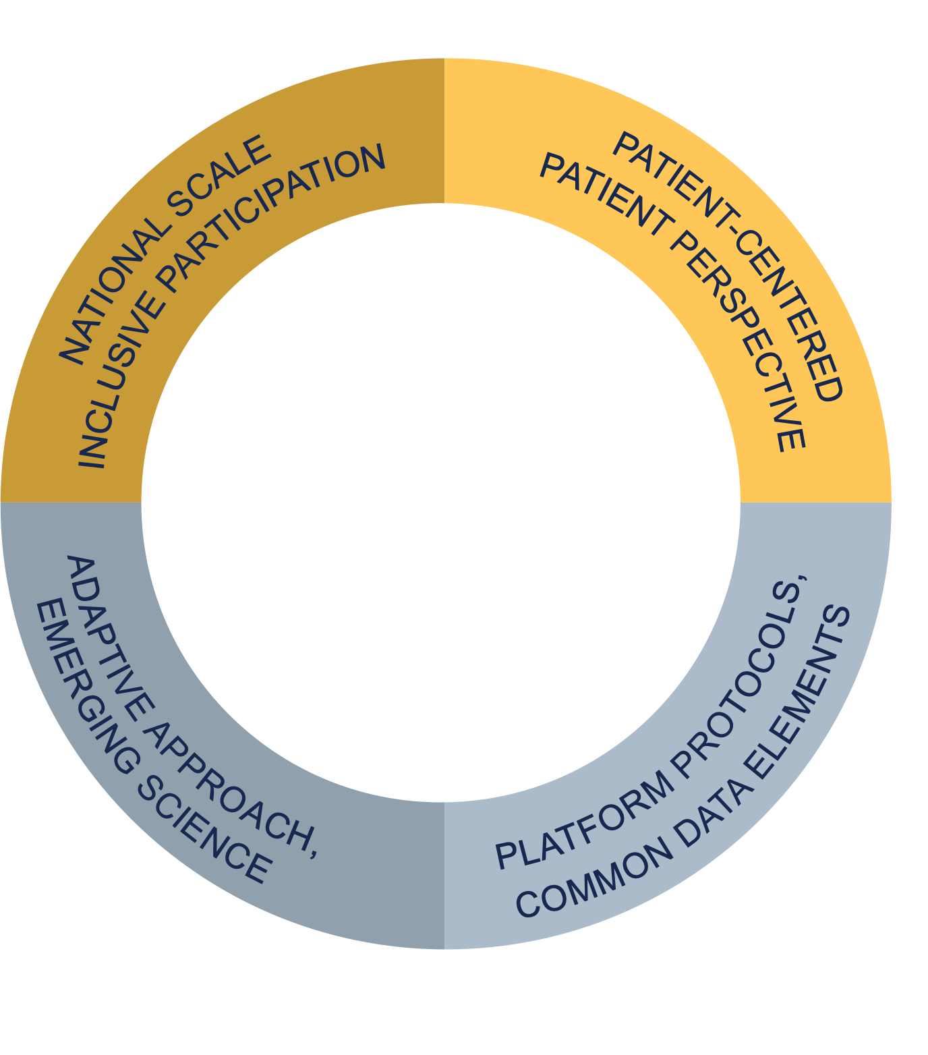
RECOVER: Researching COVID to Enhance Recovery
A PATIENT-CENTERED, INTEGRATED, ADAPTIVE RESEARCH NETWORK
SCIENTIFIC AIMS
1
Understand the range of recovery and changes in our bodies over time.
Define risk factors, number of people getting Long COVID, and if there are specific, different Long COVID types.
Study how Long COVID progresses over time and how that may relate to other illnesses.
Identify possible treatments to help with Long COVID symptoms.
2
3
4

Slide 31
RECOVER Achievements and Future Directions
Largest, diverse, deeply characterized clinical cohort of PASC patients
(Adult completion Q3; Pediatrics Q4)
Cohorts that support deep and longitudinal characterization of PASC patients
40 + pathobiology
studies that will characterize pathophysiology of PASC
5 master protocol-driven platform clinical trials poised to launch
EHR studies providing
insights on PASC prevalence, risk factors, impact, disparities
Analysis of 60 million records with >7 million COVID cases across diverse populations
Biomarker testing underway
Mobile health platform; deployment of the smartphone app
Collaborative patient community engagement
Characterized impacts of different variants and vaccination

Slide 32
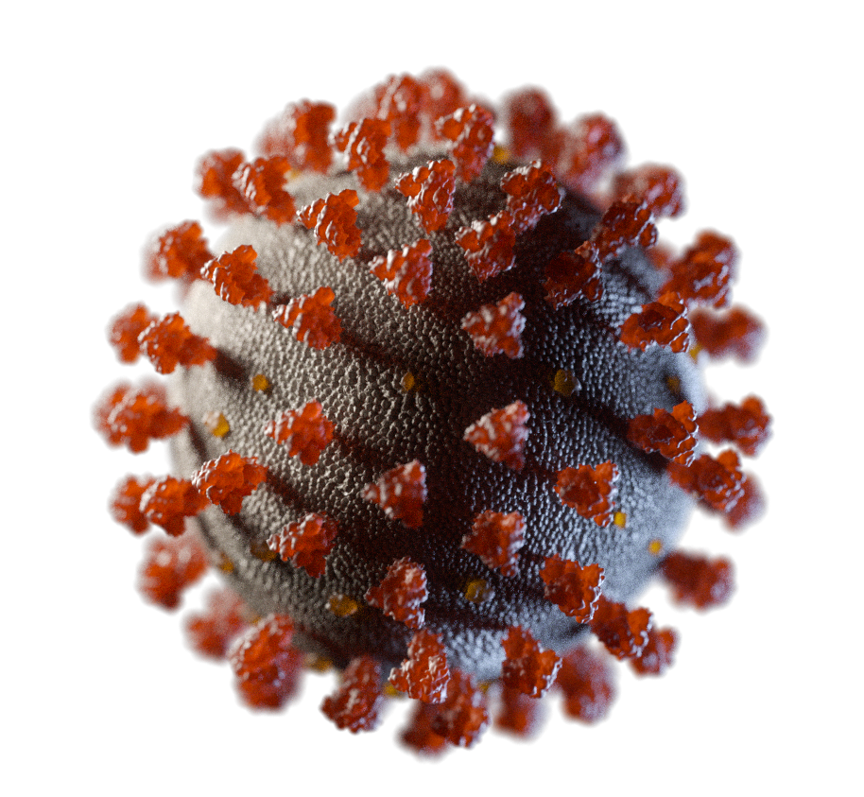
Accelerating COVID-19 Therapeutic Interventions and Vaccines (ACTIV)
Ongoing clinical trials
ACTIV-2D/"SCORPIO-HR" (novel Shionogi oral antiviral in outpatients)
ACTIV-4 Host Tissue (oral fostamatinib in inpatients)
ACTIV-6 Repurposed Drugs (oral montelukast in outpatients)
STRIVE (novel Shionogi oral antiviral in inpatients) - aims to maintain a global clinical trials infrastructure for pandemic preparedness

Slide 33
ACTIV Status and Outputs
Enrollments & Activation
Publications
49 Scientific Publications in 7 Medical Journals
23,000+ Patients enrolled into ACTIV trials
312 Sites enrolling
Cited 1985 times according to Google Scholar

Slide 34
Agent Reviews & Authorizations
800+
EUA ACHIEVEMENTS:
Lilly LY-CoV-555
Brii Bio Brii-196/Brii-198
AstraZeneca’s AZD7442 (IV) applied for EUA intending to have ACTIV outpatient data noted in the submission package
Molnupiravir and paxlovid, granted EUA, used the ACTIV protocols
ACTIV-4A work on heparin and other anticoagulants changed clinical practice
Agents reviewed
34
Agents and combinations fully enrolled and completed testing
6
Agents proven efficacious against COVID-19

Slide 35
Topics for Today Initiatives updates
NIH Leadership Changes
Awards
SRLM Groundbreaking
NIH Virtual Tour
DEIA Strategic Plan
UNITE Update
Simplifying Review Criteria
NRSA Update
COVID Updates
Initiatives Updates
Budget and Legislative Updates
Transitions

Slide 36
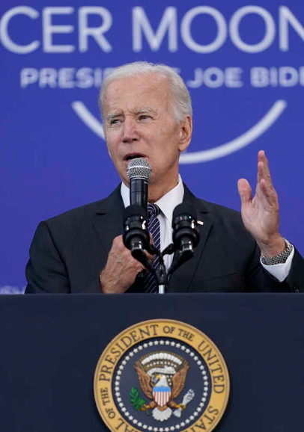
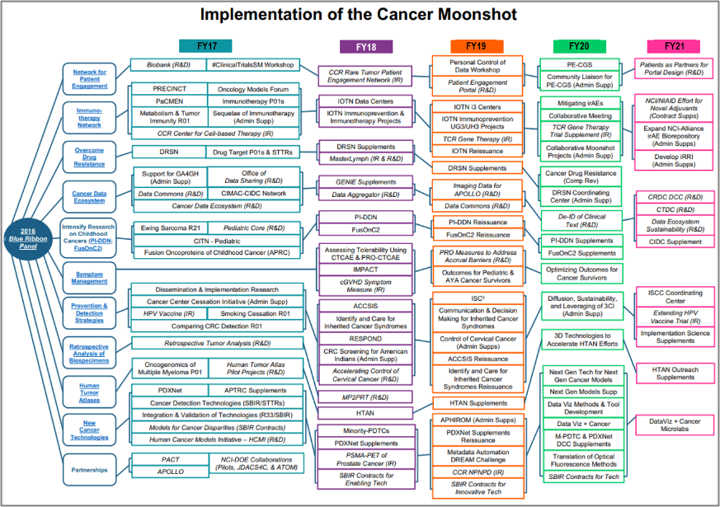
Cancer MoonshotSM
December 2016
21st Century Cures Act
Cancer Moonshot Blue Ribbon Panel Report
Precision Medicine Initiative $1.45 billion over 10 years
Beau Biden Cancer Moonshot $1.8 billion over 7 years
BRAIN Initiative
$1.511 million over 10 years
Regenerative Medicines
$30 million over 4 years
February 2022
President Biden Reignites the Cancer Moonshot with new goals
Implementation

Slide 37
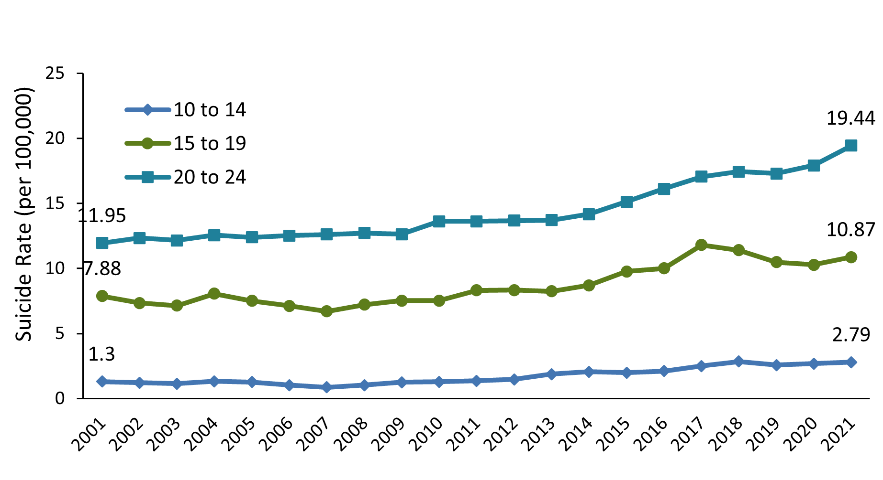
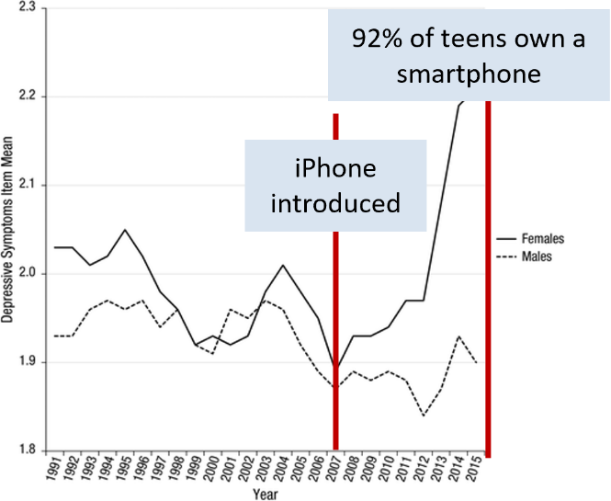
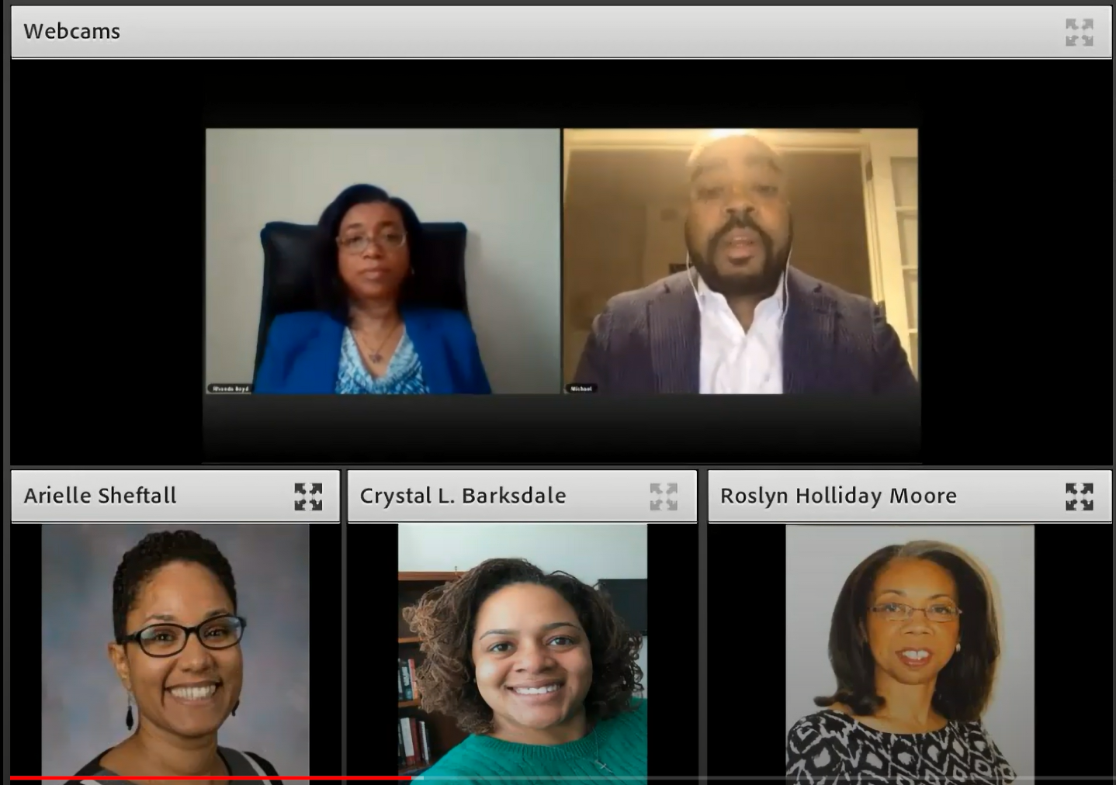
NIH is Addressing the Youth Mental Health Crisis
Crude Suicide Rates Among Youth in the United States (2001-2021)
Data Courtesy of CDC
NIH Youth Mental Health Activities and Initiatives
Bidirectional Influences Between Adolescent Social Media Use and Mental Health (RFA-MH-23-115/-116)
Understanding Suicide Risk and Protective Factors among Black Youth (RFA-MH-22-140/141)
Assessment of Suicide Thoughts and Behaviors among Children and Preteens (NOT-MH-22-086)
School-Based Suicide Prevention: Promising Approaches and Opportunities for Research (January 2022 webinar)
Four roundtables: Risk, Resilience, and Trajectories in Preteen Suicide (January-June 2021)
Adolescents who spent more time on new media were more likely to report mental health issues
Responding to the Alarm: Addressing Black Youth Suicide

Slide 38
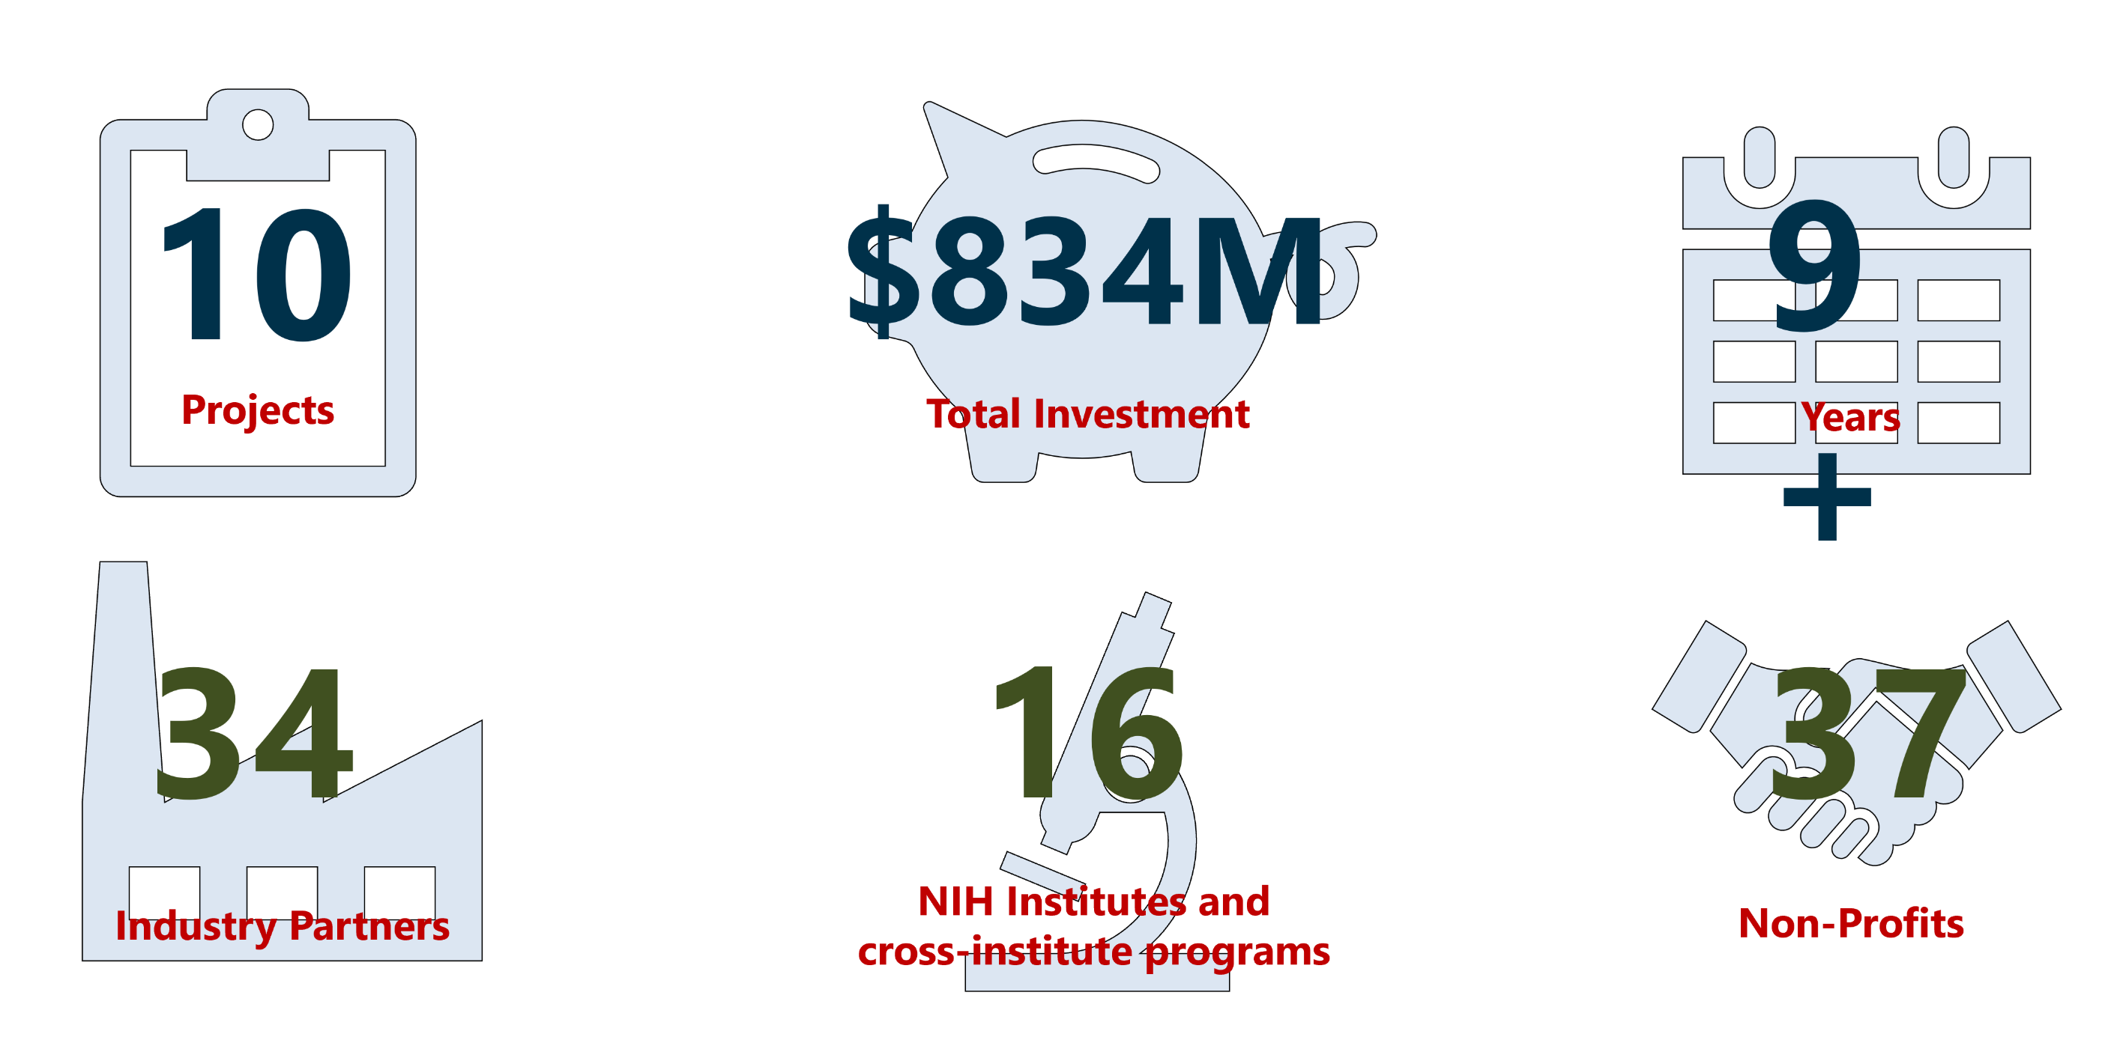
The Accelerating Medicines Partnership® (AMP®) By the Numbers
As of May 2023

Slide 39
The Accelerating Medicines Partnership® (AMP®) Program timelines
As of May 2023

Slide 40
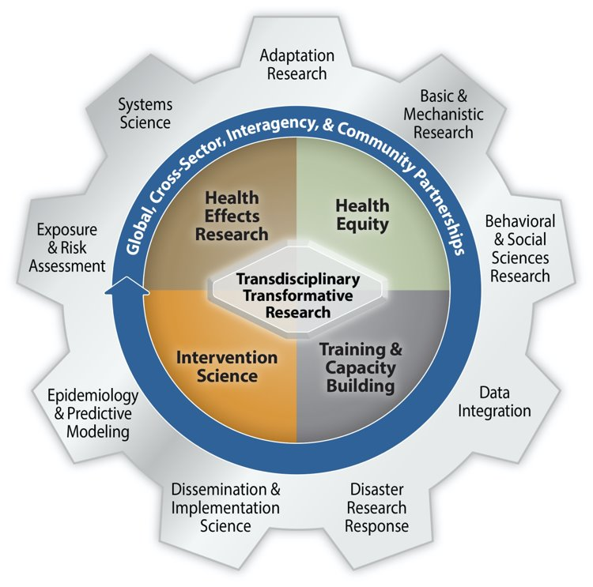
NIH Wide Collaborative Initiative on Climate Change and Health
Leadership from an Executive Committee of seven NIH IC Directors
NICHD, NHLBI, FIC, NIMH, NIMHD, NIEHS, NINR
Goal: Reduce health threats across the lifespan and build health resilience in individuals, communities, and nations around the world, especially among those at highest risk.
Research strategy focused on multidisciplinary approaches:
Health Effects Research
Health Equity
Intervention Science
Training and Capacity Building
Broad assortment of supporting science ranging from:
Basic mechanistic research
Data integration
Behavioral and social sciences research
Disaster research response
Etc.
www.nih.gov/climateandhealth

Slide 41
Many Institutes and Centers: One Mission

Slide 42
NIH HEAL Initiative in 2023
Supporting science-based solutions to the opioid crisis
Over $2.5 billion in research, more than 1,000 research projects
42 research programs, projects in all 50 states
314 clinical trials under way
More than 100 projects addressing back pain alone
More than 200 projects addressing medications for opioid use disorder
41 FDA approvals for investigational new drugs or devices
Active, ongoing partnerships with federal agencies, private sector, academia, and communities

Slide 43
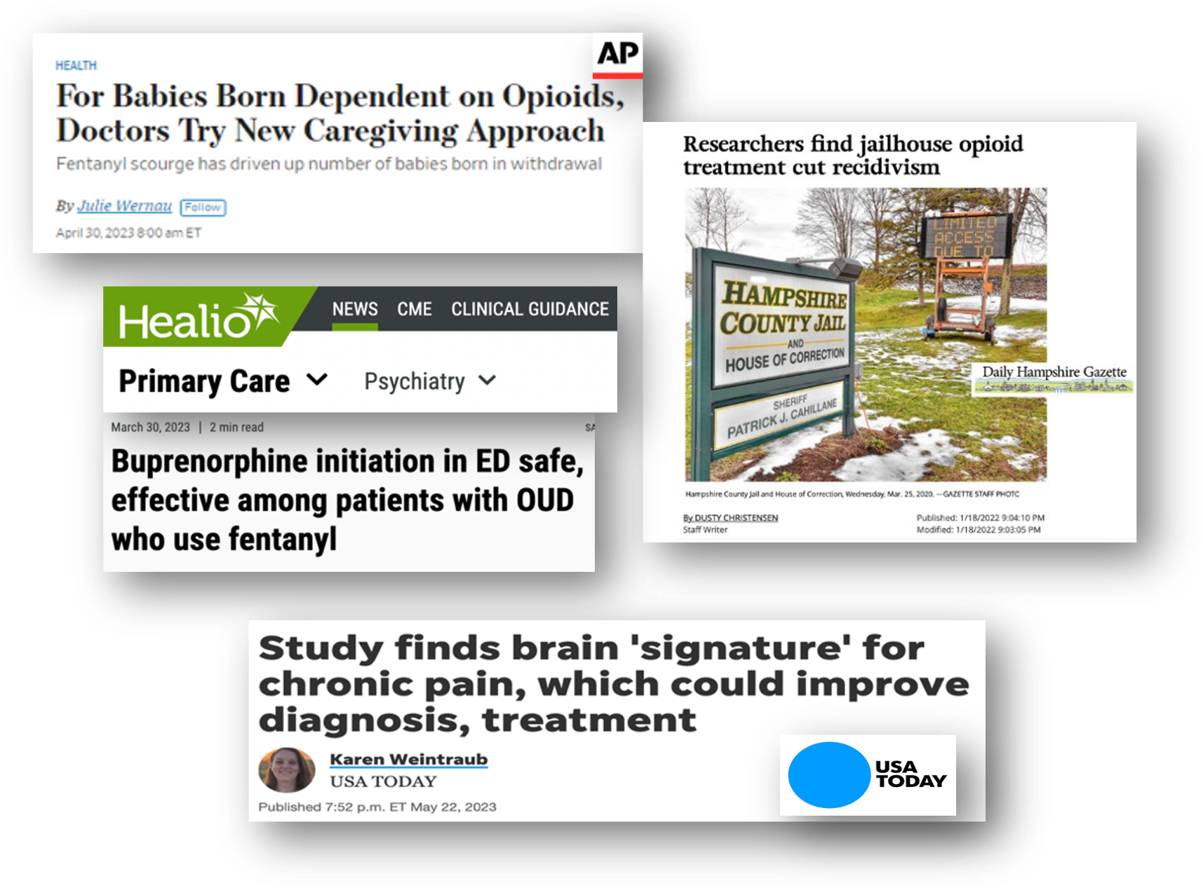
HEAL is Making a Difference
New standard of care for infants born dependent on opioids
Patient-specific chronic pain brain signature
Buprenorphine safe and effective in the emergency room in the era of fentanyl
Opioid addiction treatment in jail reduced recidivism by 30%

Slide 44
Topics for Today Budget and Legislative Updates
NIH Leadership Changes
SRLM Groundbreaking
NIH Virtual Tour
DEIA Strategic Plan
UNITE Update
Simplifying Review Criteria
NRSA Update
COVID Updates
Initiatives Updates
Budget and Legislative Updates
Transitions

Slide 45
Legislative Update
Lauren Higgins
Acting Director for Legislative Policy & Analysis
June 8, 2023

Slide 46
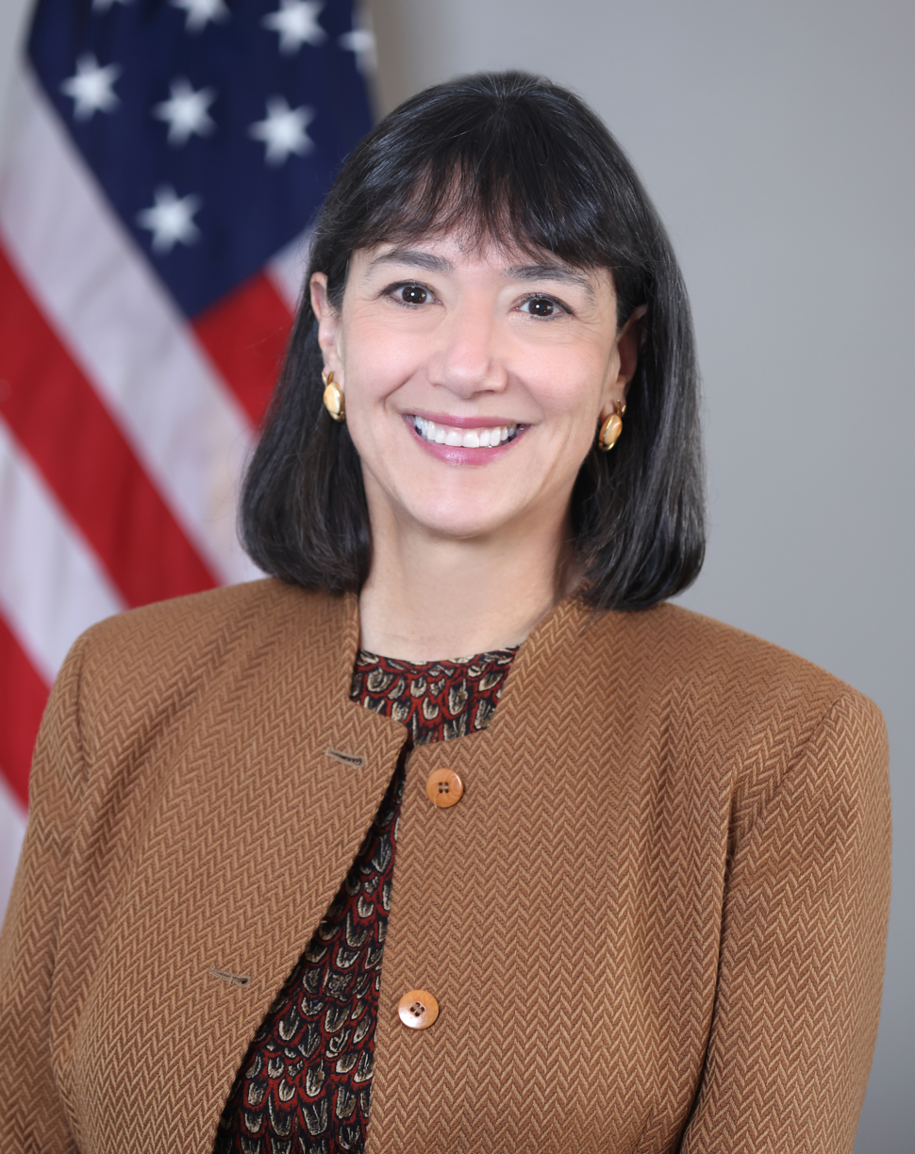
Nominee for NIH Director
The Nomination Process – What to expect:
President Announced Nomination in May
Meetings with Senate Members
Senate Confirmation Hearing with HELP Committee
Senate HELP Committee Vote
Full Senate Confirmation Floor Vote

Slide 47
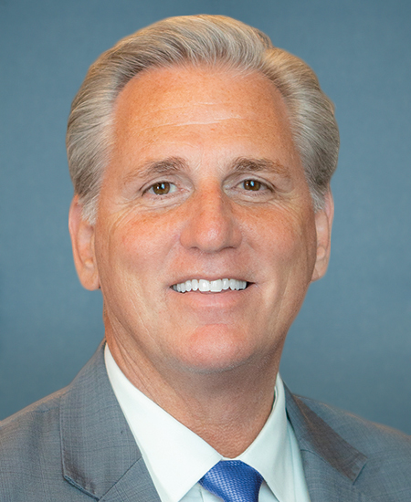
Congressional Leadership Updates
Election for House Speaker – contentious first week of the 118th Congress.
15 ballots cast over 4 days before Speaker Kevin McCarthy won.
House Democratic leadership – generational shift.
Minority Leader Hakeem Jeffries replaces Rep. Nancy Pelosi.
Both chambers have a narrow margin of control.
Sen. Chuck Schumer – Senate Majority Leader.
Sen. Mitch McConnell – Senate Minority Leader.
Speaker of the House Kevin McCarthy

Slide 48
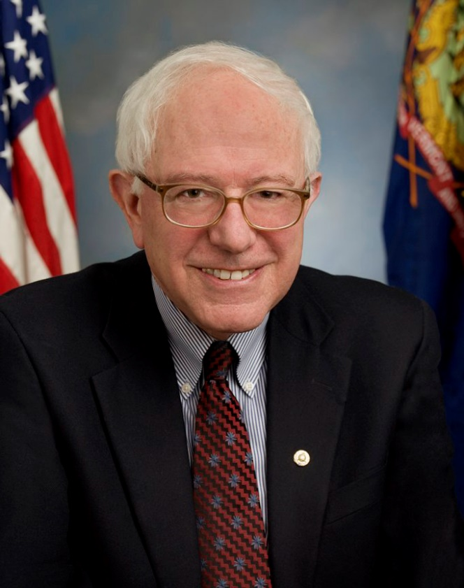
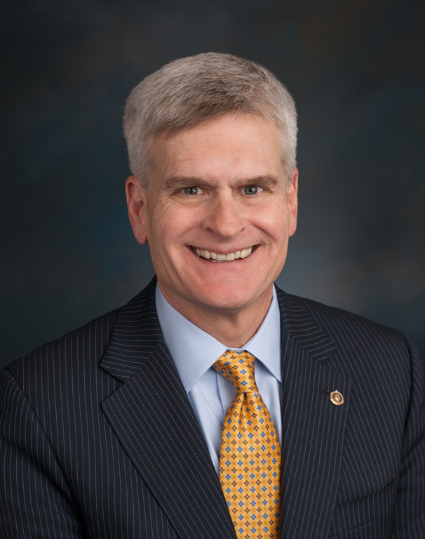
Congressional Leadership Updates Senate HELP Committee
Chair Bernie Sanders
Ranking Member Bill Cassidy
Priorities: Drug pricing, aging, and disability
Priorities: Mental health, burden of disease, and hepatitis

Slide 49
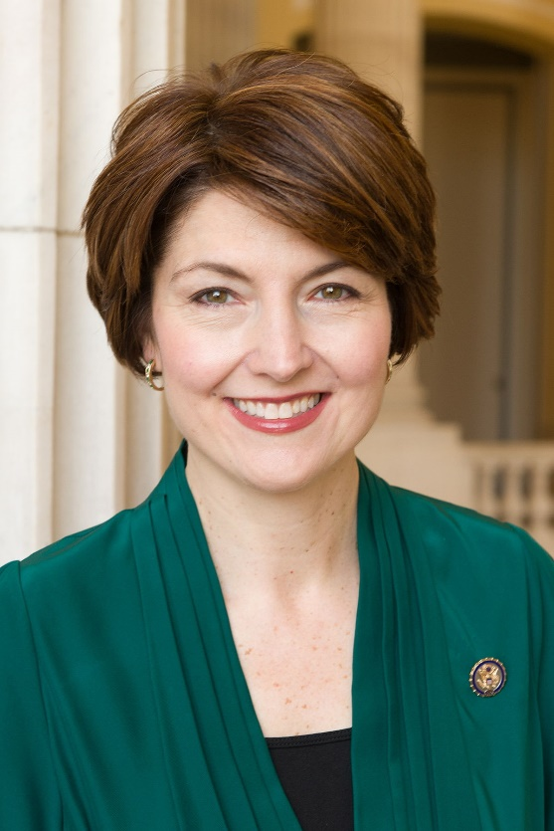
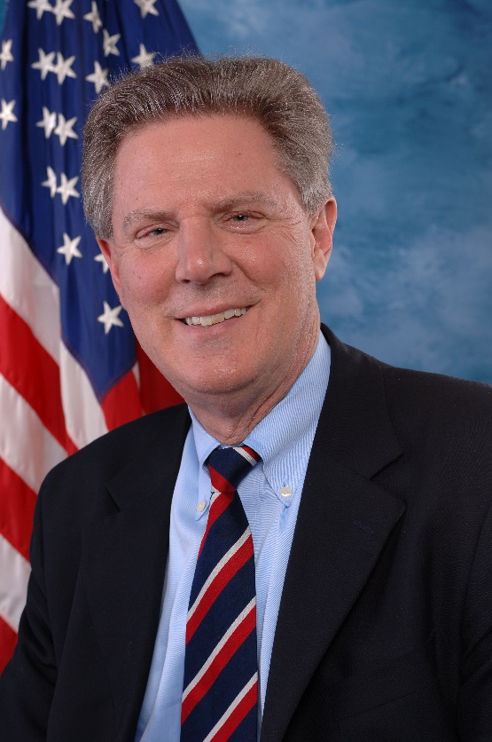
Congressional Leadership Updates House Energy and Commerce Committee
Chair Cathy McMorris Rodgers
Ranking Member Frank Pallone
Priorities: Down Syndrome, NIH Reform, and Oversight of the COVID-19 Response
Priorities: Sudden Infant Death Syndrome, Clinical Trials Reporting, and 21st Century Cures

Slide 50
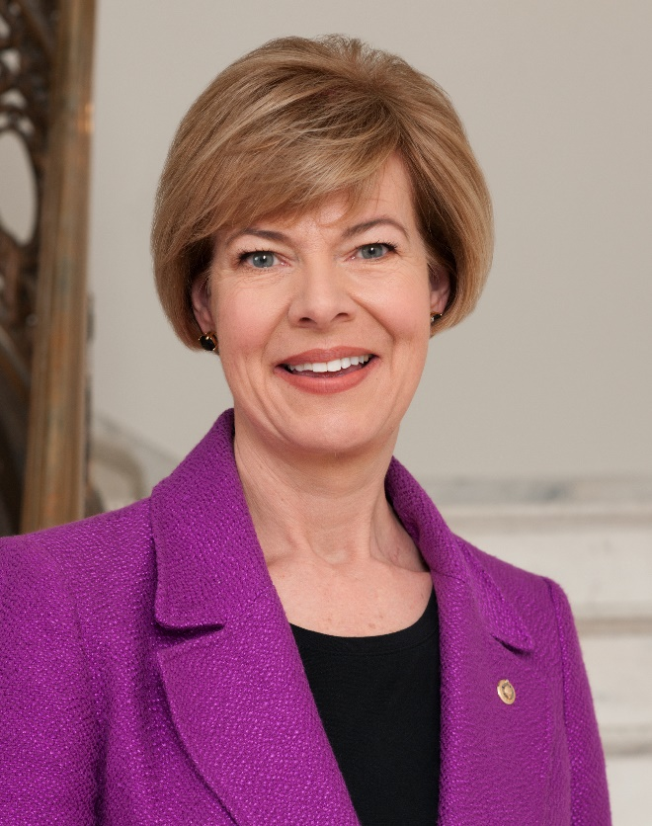
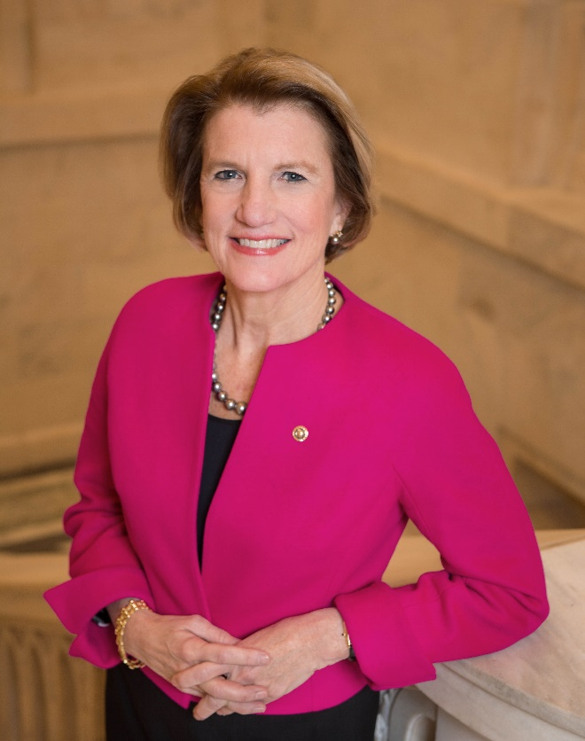
Congressional Leadership Updates Senate Appropriations - LHHS
Chair Tammy Baldwin
Ranking Member Shelley Moore Capito
Priorities: Health disparities, LGBT, and Next Generation Research Initiative
Priorities: Alzheimer’s Disease, Opioids, and IDeA States

Slide 51
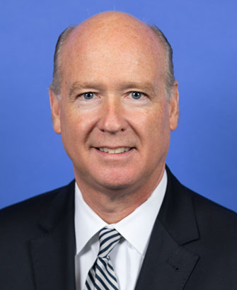
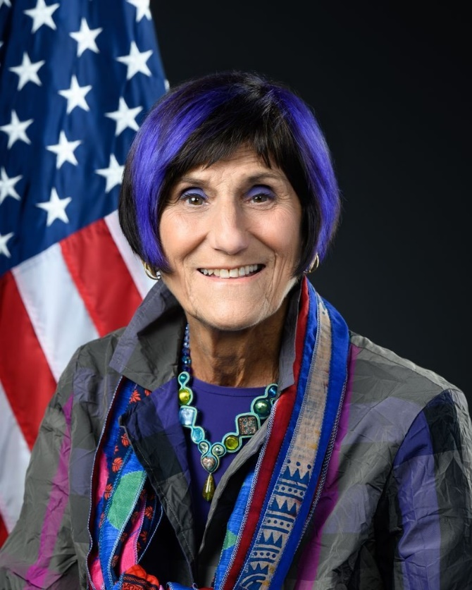
Congressional Leadership Updates House Appropriations - LHHS
Chair Robert Aderholt
Ranking Member Rosa DeLauro
Priorities: COVID-19 response
Priorities: Firearms research, opioids, ALS

Slide 52
Snapshot of Activities
3 Hearings
4 Campus Visits
5 Roundtables
79 Briefings
55 Requests for Information
NIH Office of Legislative Policy & Analysis

Slide 53
FY 2024 Appropriations Hearings
Themes Discussed:
Early-Stage Investigators
Alzheimer’s Disease
Youth Mental Health
Childhood Cancer
Fentanyl and Opioids
ARPA-H Funding
Children and technologies
COVID-19 Response

Slide 54
Looking Forward
Must Pass Legislation
Possible Activities
FDA User Fee Programs for Animal Drug and Animal Generic Drug Expires September 30, 2023
Pandemic and All-Hazards Preparedness Act Expires September 30, 2023
Appropriations
NDAA
House focuses on waste, fraud, abuse, and oversight of federal programs. Focus on COVID-19 response and government spending
Oversight Hearings

Slide 55
Thank you

Slide 56
Topics for Today
NIH Leadership Changes
Awards
SRLM Groundbreaking
NIH Virtual Tour
DEIA Strategic Plan
UNITE Update
Simplifying Review Criteria
COVID Updates
Initiatives updates
Budget and Legislative Updates
Transitions

Slide 57
Turning Discovery Into Health
NIH…
Lawrence.Tabak@nih.gov
@NIHDirector/Twitter

