Slide 1
Legislative Update
Lauren Higgins
Acting Director for Legislative Policy & Analysis
June 8, 2023
Notes:
Cover Design 1

Slide 2
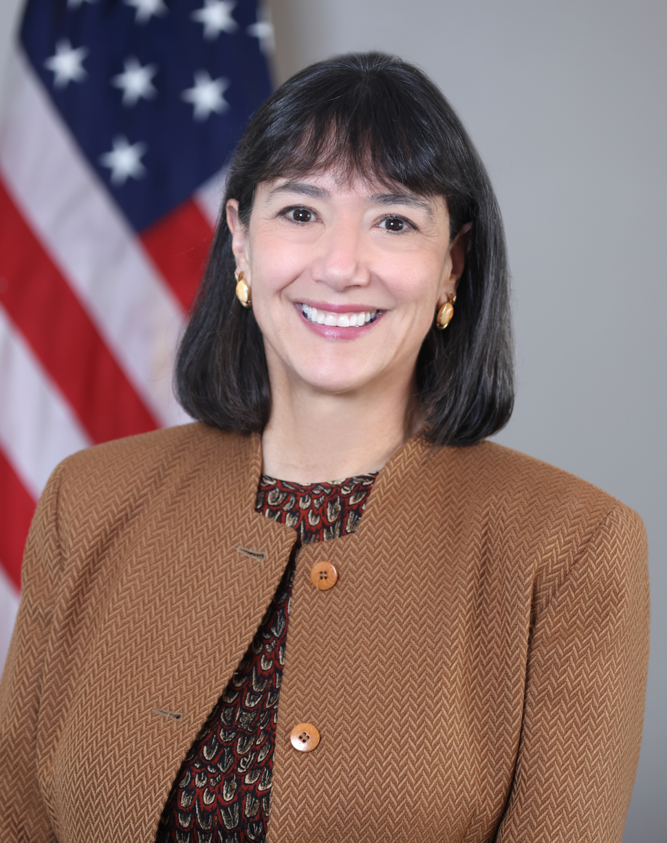
Nominee for a new NIH Director
The Nomination Process – What to expect:
President Announced Nomination in May
Meetings with Senate Members
Senate Confirmation Hearing with HELP Committee
Senate HELP Committee Vote
Full Senate Confirmation Floor Vote

Slide 3
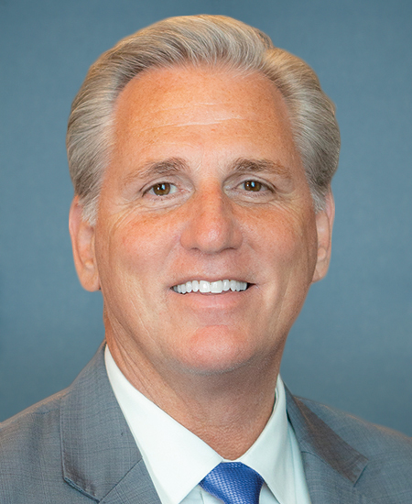
Congressional Leadership Updates
Election for House Speaker – contentious first week of the 118th Congress.
15 ballots cast over 4 days before Speaker Kevin McCarthy won.
House Democratic leadership – generational shift.
Minority Leader Hakeem Jeffries replaces Rep. Nancy Pelosi.
Both chambers have a narrow margin of control.
Sen. Chuck Schumer – Senate Majority Leader.
Sen. Mitch McConnell – Senate Minority Leader.
Speaker of the House Kevin McCarthy
Notes:
Prior to this Congress, 14 speaker elections required multiple ballots, 13 of those occurred before the Civil War. The last time was in 1923 and took 9 ballots.

Slide 4
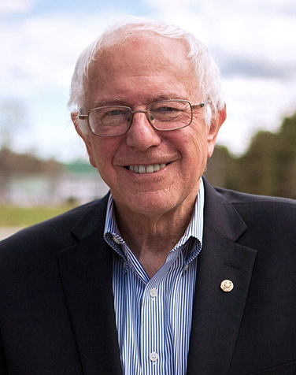
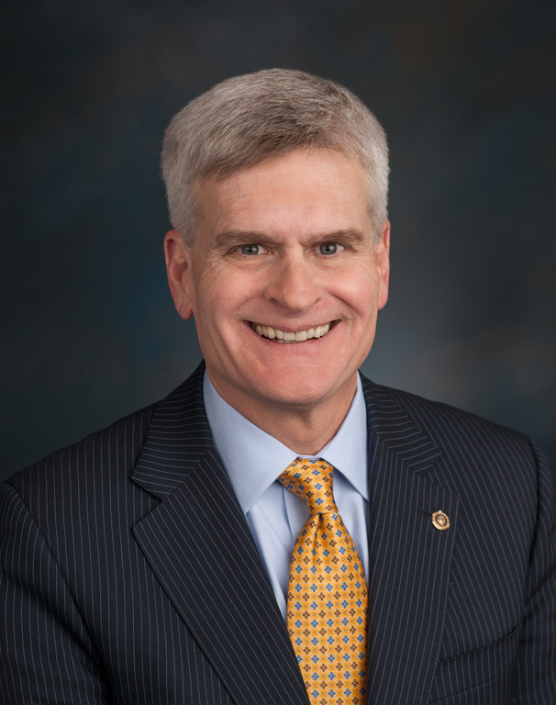
Congressional Leadership Updates Senate HELP Committee
Chair Bernie Sanders
Ranking Member Bill Cassidy
Priorities: Drug pricing, aging, and disability
Priorities: Mental health, burden of disease, and hepatitis

Slide 5
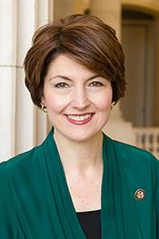
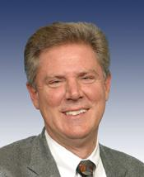
Congressional Leadership Updates House Energy and Commerce Committee
Chair Cathy McMorris Rodgers
Ranking Member Frank Pallone
Priorities: Down Syndrome, NIH Reform, and Oversight of the COVID-19 Response
Priorities: Cancer, Sudden Infant Death Syndrome, and Clinical Trials Reporting

Slide 6
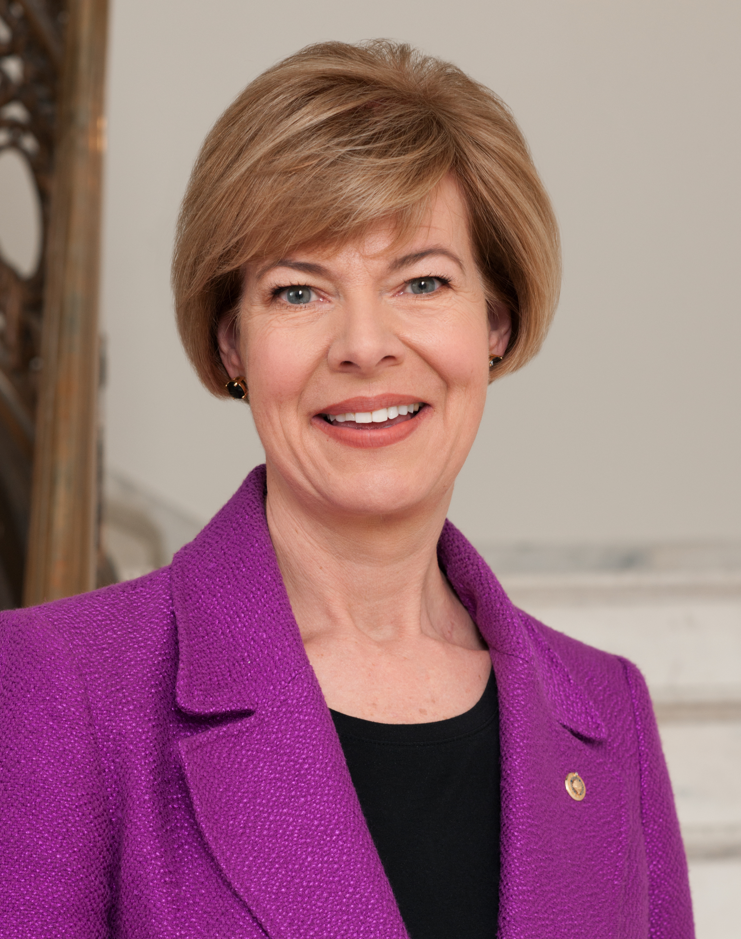
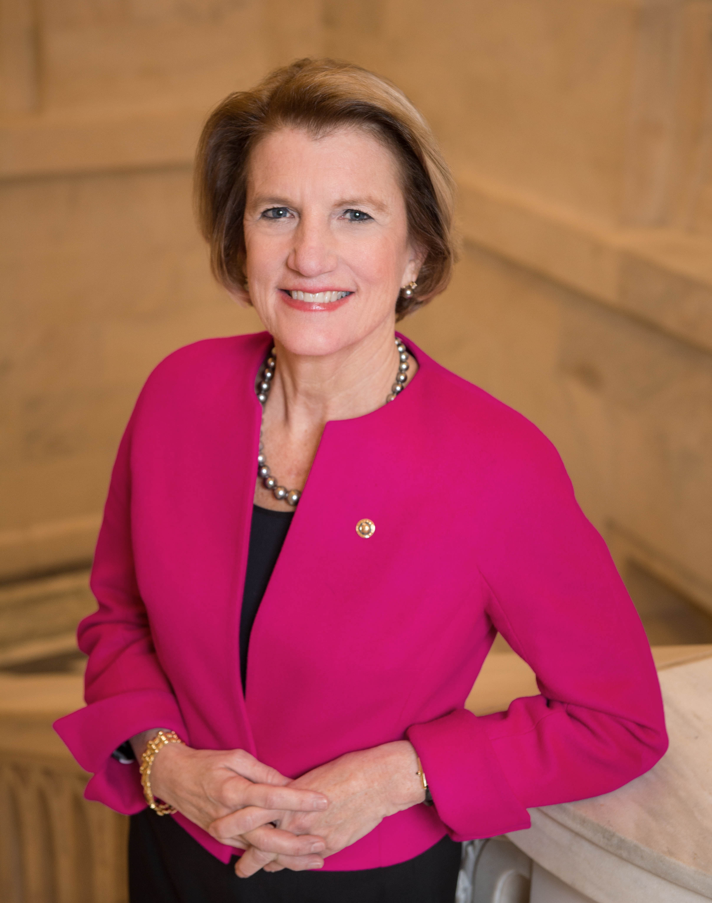
Congressional Leadership Updates Senate Appropriations - LHHS
Chair Tammy Baldwin
Ranking Member Shelley Moore Capito
Priorities: Health disparities, LGBT, and Next Generation Research Initiative
Priorities: Alzheimer’s Disease, Opioids, and IDeA States

Slide 7
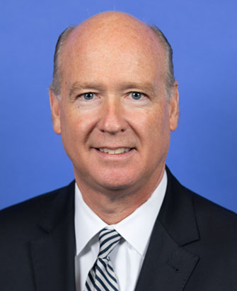
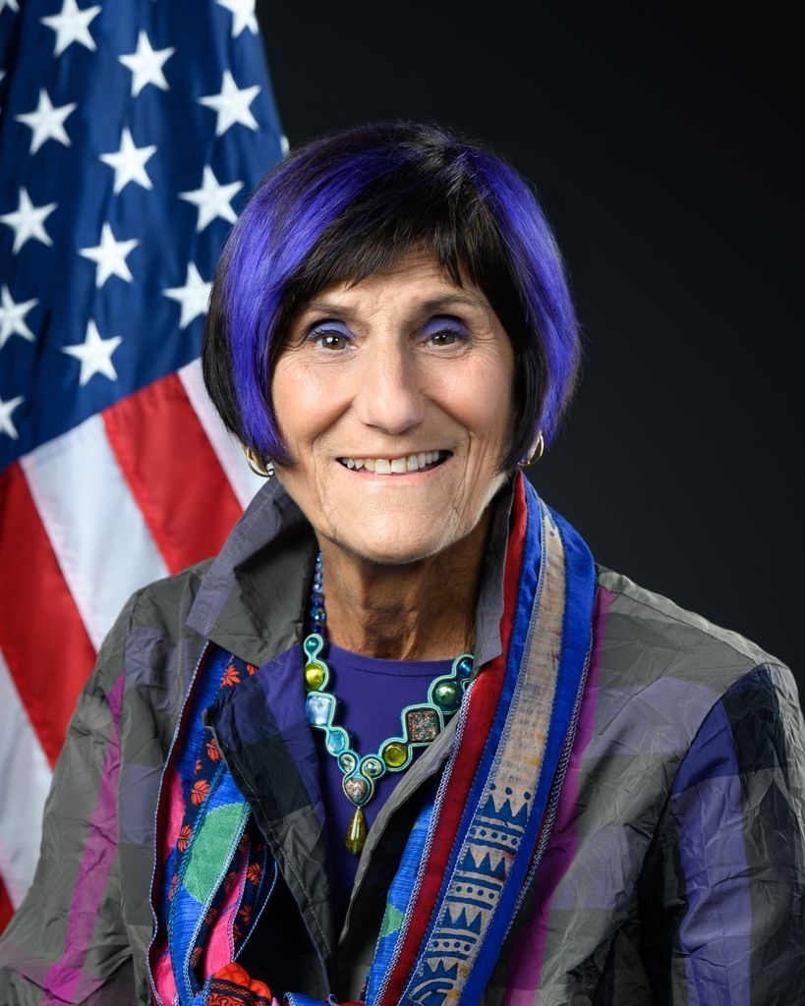
Congressional Leadership Updates House Appropriations - LHHS
Chair Robert Aderholt
Ranking Member Rosa DeLauro
Priorities: COVID-19 response
Priorities: Firearms research, opioids, ALS

Slide 8
Snapshot of Activities
3 Hearings
4 Campus Visits
5 Roundtables
79 Briefings
55 Requests for Information
NIH
Office of Legislative Policy & Analysis

Slide 9
FY 2024 Appropriations Hearings
Themes Discussed:
Early-Stage Investigators
Alzheimer’s Disease
Youth Mental Health
Childhood Cancer
Fentanyl and Opioids
ARPA-H Funding
Children and technologies
COVID-19 Response

Slide 10
Looking Forward
Must Pass Legislation
Possible Activities
FDA User Fee Programs for Animal Drug and Animal Generic Drug
Expires September 30, 2023
Pandemic and All-Hazards Preparedness Act
Expires September 30, 2023
Appropriations
NDAA
House focuses on waste, fraud, abuse, and oversight of federal programs. Focus on COVID-19 response and government spending
Oversight Hearings
Drug Pricing Bill

Slide 11
Thank you
Notes:
Cover Design 1

