Slide 1
PROMOTING EQUITABLE ACCESS TO RESEARCH RESULTS An Integrated Approach
NATIONAL INSTITUTES OF HEALTH
Lyric Jorgenson, PhD Acting NIH Associate Director for Science Policy Acting Director of the Office of Science Policy
Meeting of the Advisory Committee to the NIH Director
June 8, 2023
This presentation has presenter’s notes.

Slide 2
Goals for today’s conversation
Discuss importance of promoting access to research results
Review NIH’s New Public Access Plan and associated proposal
Chart path forward for incentivizing a culture of open science

Slide 3
Why We’re Here
USG policy initiatives underway to increase meaningful and equitable access
Access to federally funded research data
Access to federally funded research publications
NIH is a leader here, in access and transparency to biomedical research products
Catalyzes research advances
Improves access to health knowledge and interventions
Is essential for building trustworthiness in science
Impacts of NIH policy initiatives are most often felt by the researchers we serve, whether it is change in practice or need for new systems.
We need to make change meaningful.

Slide 4
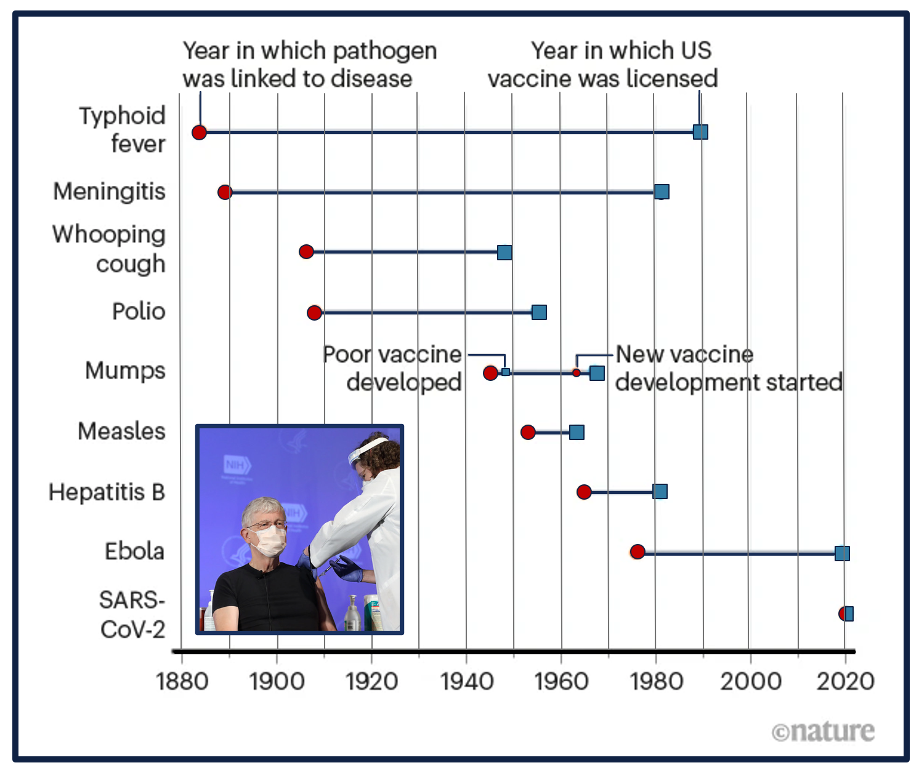
Some Examples Making Good on The public’s investment in science
Pandemic sharing and immediate access to:
> 2.5M SARS COV-2 genomic sequences
> 1,300 SARS-CoV-2 protein structures
> 300 reagents for biomedical research
> 7.3B rows of clinical data (N3C)
> 150K papers
Source: niaid.nih.gov

Slide 5
Some Examples Making Good on The public’s investment in science
% of U.S. adults who say when they hear each of the following, they trust scientific research findings...
https://www.pewresearch.org/science/wp-content/uploads/sites/16/2019/08/PS_08.02.19_trust.in_.scientists_FULLREPORT.pdf

Slide 6
NIH VISION An Integrated Ecosystem for research outputs
FAIR Principles
Metadata
Consent & Privacy
Storage Costs
Interoperability
Data Standards
Curation Costs
Security & Integrity
Data Agreements
Common Data Elements
Public Access
Persistent Identifiers (PIDs)

Slide 7
Some context NIH’s Long-Standing Commitment To Access
2003 NIH Data Sharing Policy (awards >500K)
2008 NIH Public Access Policy
2014 NIH Genomic Data Sharing Policy (human & non-human genomic data)
2015 NIH Intramural Human Data Sharing Policy
2016 NIH Policy on Dissemination of NIH-Funded Clinical Trial Information
2020 NIH Data Management and Sharing Policy (effective 2023)
IC/program-specific policies and guidelines (i.e., HEAL Initiative and Cancer Moonshot Public Access and Data Sharing Policies)

Slide 8
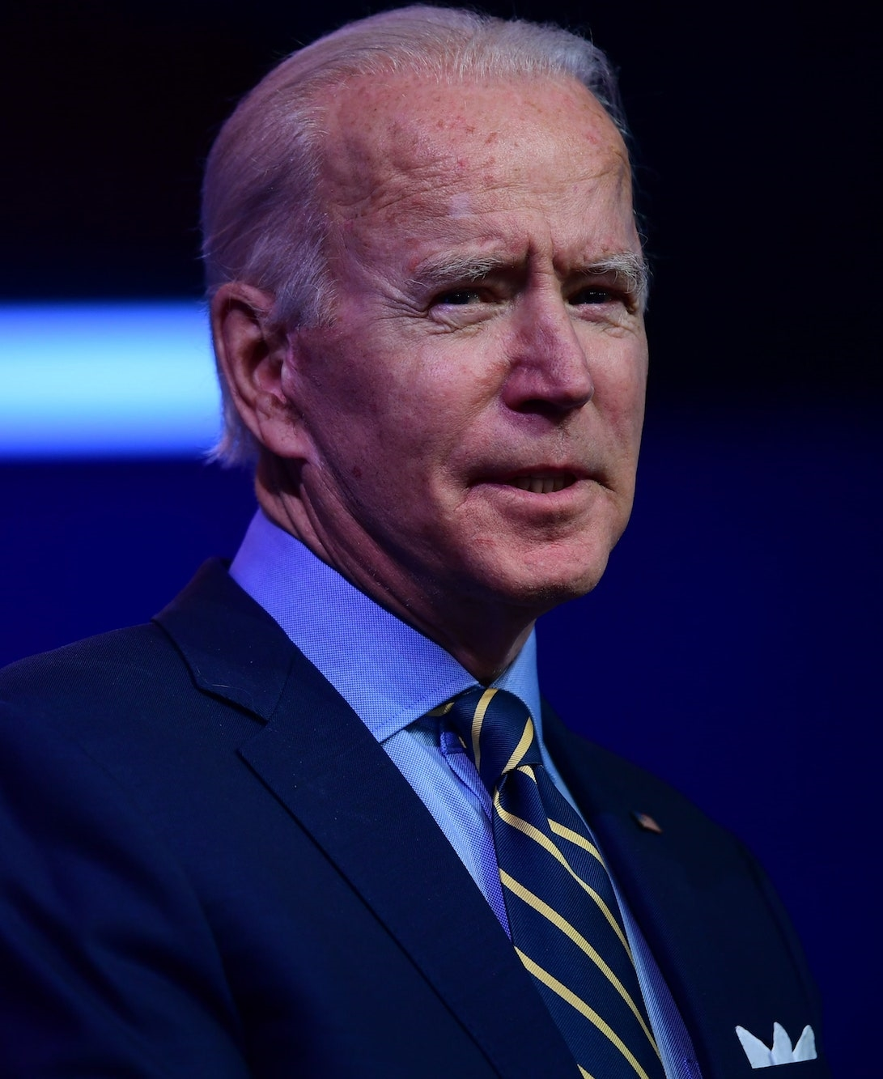
What’s New in 2023
White House Directive on Ensuring Free, Immediate, and Equitable Access to Federally Funded Research (released in 2022)
Ensure federally funded publications freely available, publicly accessible without embargo
Make scientific data underlying publications accessible at time of publication
Develop approaches for sharing all scientific data
Establish policies for use of metadata and persistent identifiers to make research products more findable and transparent
"Increasing the pool of researchers who can access data and decreasing the time it takes for them to review and find new patterns in that data is critical to speeding up development of lifesaving treatments for patients.“
- Joe Biden

Slide 9
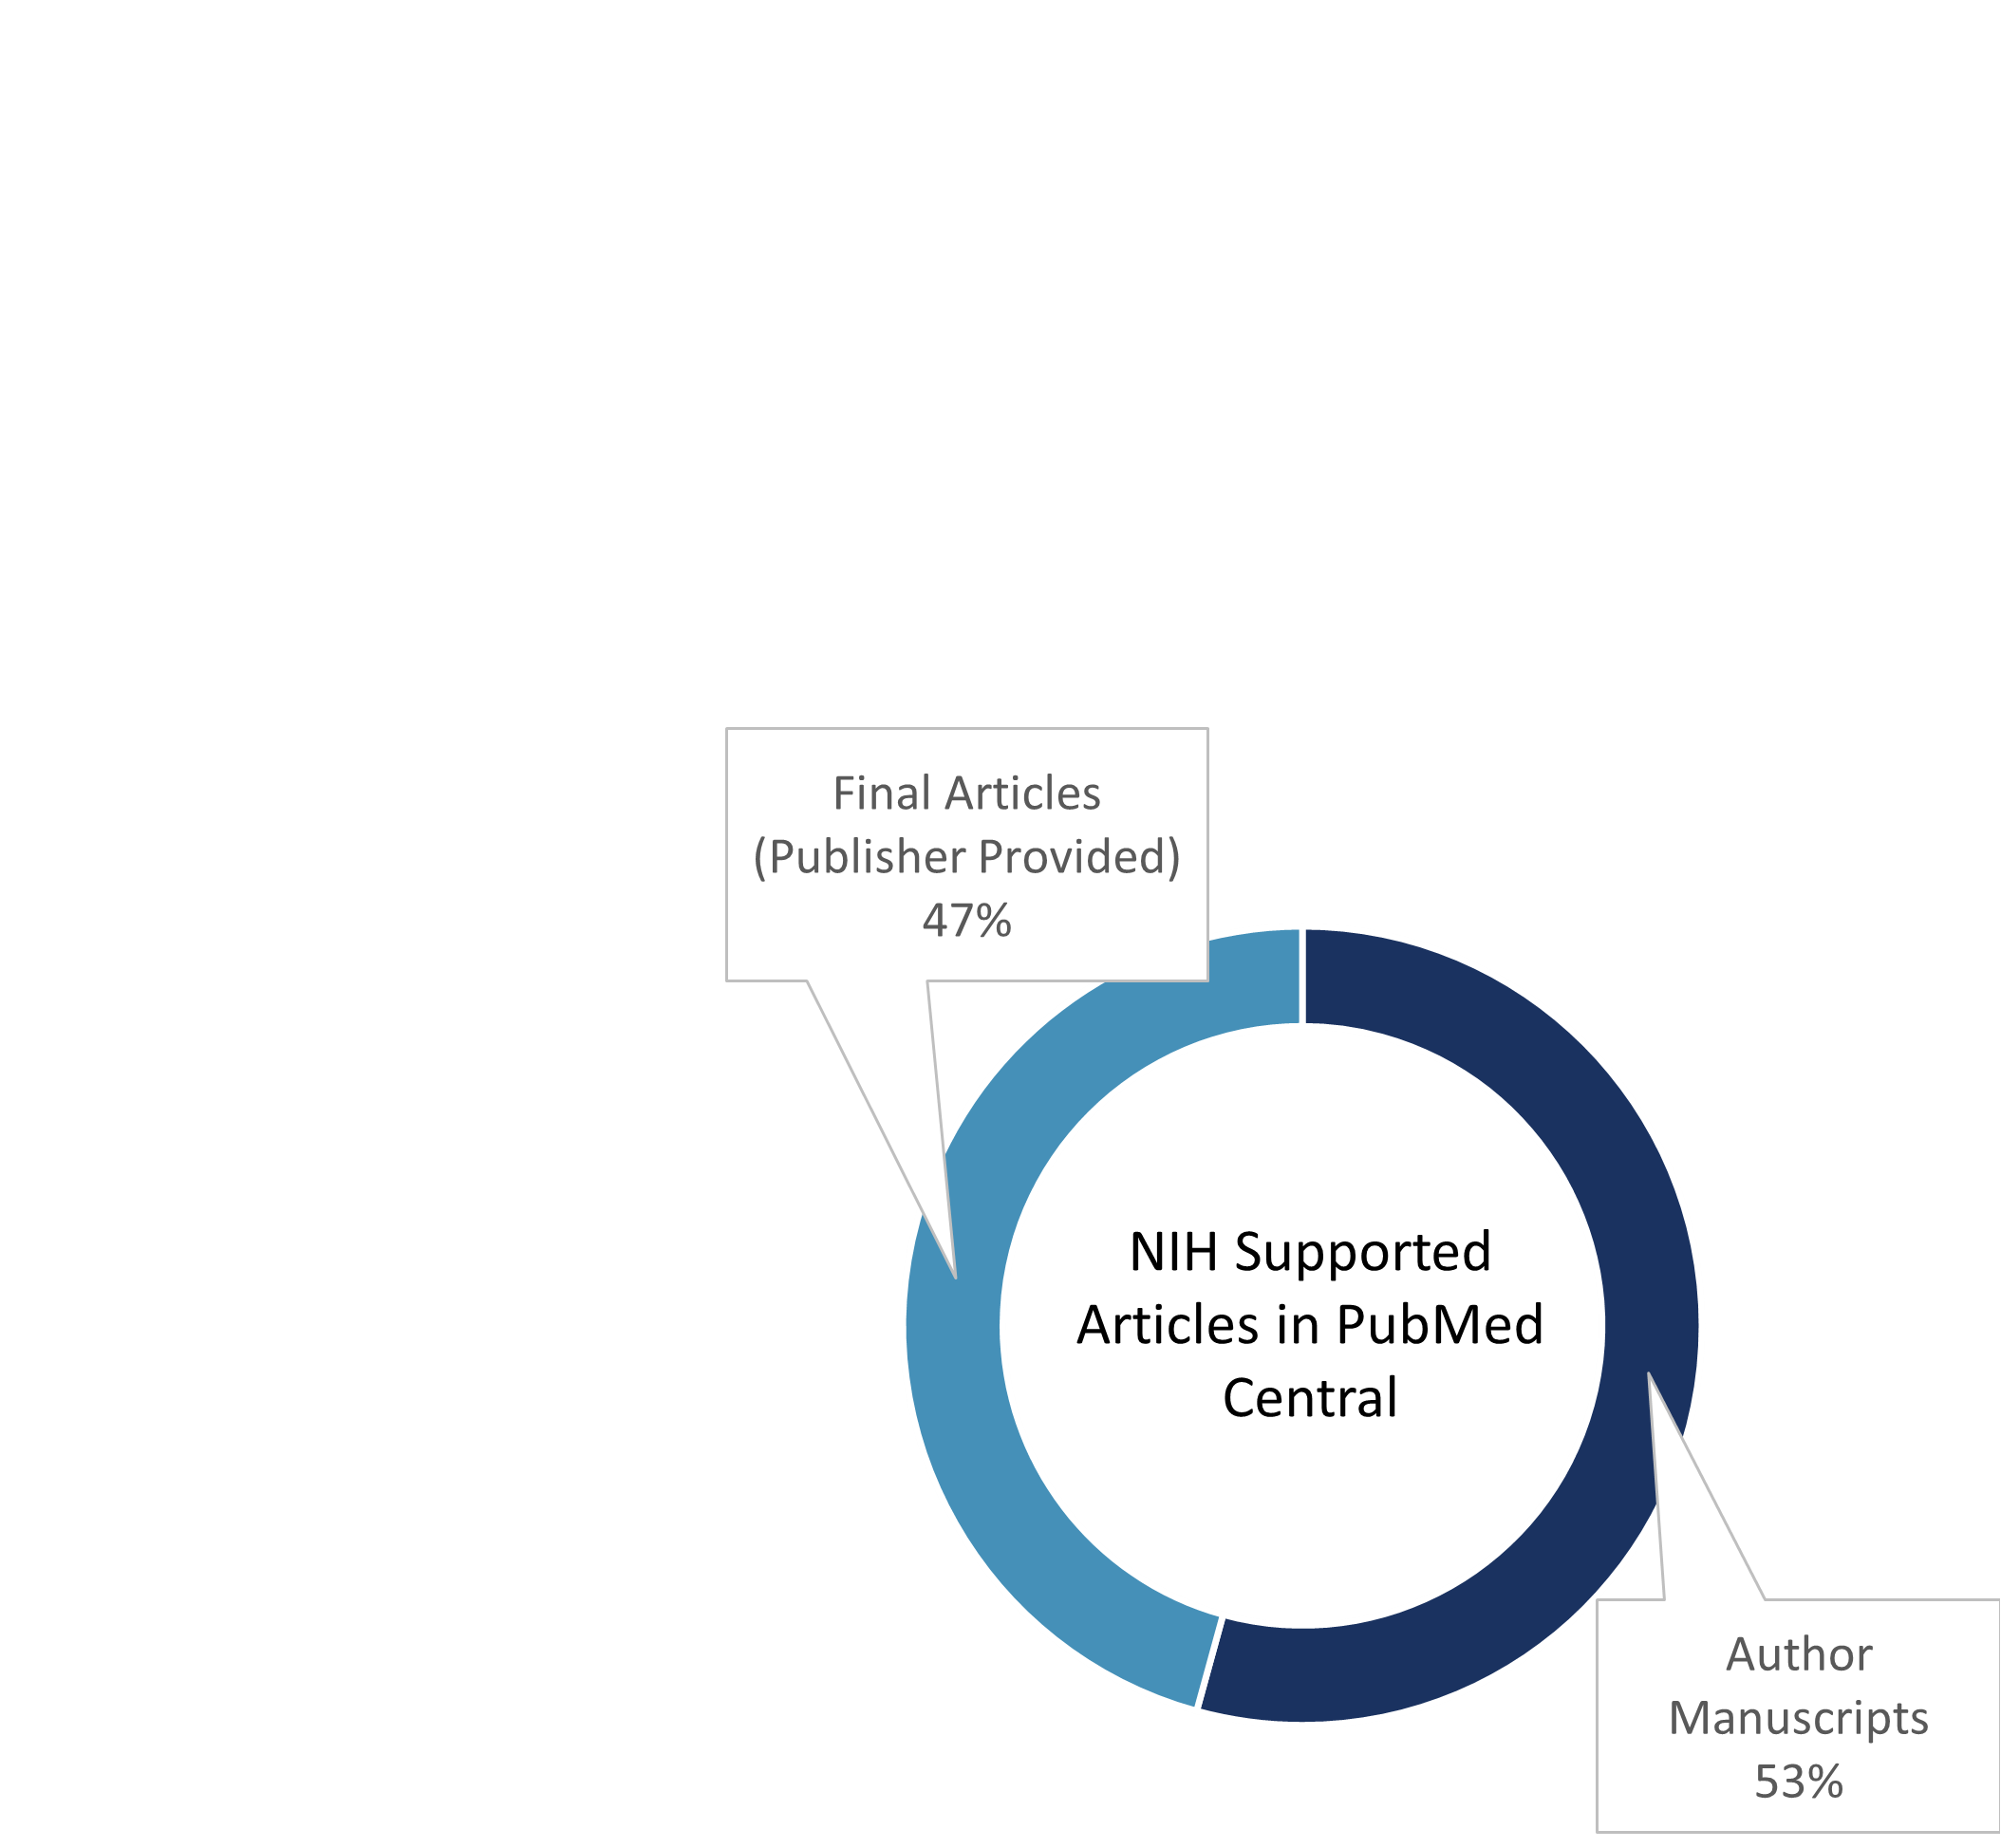
NIH BUILDING OFF an already Strong Foundation
2020 Data Management and Sharing Policy
Makes scientific data underlying publications accessible at time of publication
Develops approaches for sharing all scientific data
2008 Public Access Policy
1.4 million NIH-supported articles (2008-present)
> 100,000 added annually
1/3 submitted with NO embargo
This Photo by Unknown Author is licensed under CC BY

Slide 10
HOW TO GET TO ZERO EMBARGO

Slide 11
Public Access to Publications CURRENT POLICY PROPOSAL
On or by
Dec 31, 2025
Revised Public Access Policy Effective
Expectation from 2022 OSTP Memo | Current Practices To Continue | New Practices NIH Will Institute | New Practices Proposed
Peer-reviewed scholarly publications… made freely available, publicly accessible in agency-designated repositories without embargo after publication | PMC serves as repository Manuscripts submitted to PMC at time of acceptance OR Journals with agreements with NIH will submit on authors’ behalf when published | Articles will be available post-publication in PMC as soon as processing is complete, without an embargo period | Clarify rights necessary to comply Clarify official date of publication (online vs. print)

Slide 12
Public Access to Publications CURRENT POLICY PROPOSAL (cont.)
On or by
Dec 31, 2025
Revised Public Access Policy Effective
Expectation from 2022 OSTP Memo | Current Practices To Continue | New Practices NIH Will Institute | New Practices Proposed
Peer-reviewed scholarly publications… made freely available, publicly accessible in agency-designated repositories without embargo after publication | PMC serves as repository Manuscripts submitted to PMC at time of acceptance OR Journals with agreements with NIH will submit on authors’ behalf when published | Articles will be available post-publication in PMC as soon as processing is complete, without an embargo period | Clarify rights necessary to comply Clarify official date of publication (online vs. print)
Maximize equitable reach of public access to peer-reviewed scholarly publications…in formats that allow for machine-readability | PMC converts submissions to human- and machine- readable formats and allows for use of metadata | Work with community to develop/update standards for article accessibility procedures, for submission to PMC | *Actively seeking public input and ideas*

Slide 13
Public Access to Publications CURRENT POLICY PROPOSAL (cont.)
On or by
Dec 31, 2025
Revised Public Access Policy Effective
Expectation from 2022 OSTP Memo | Current Practices To Continue | New Practices NIH Will Institute | New Practices Proposed
Peer-reviewed scholarly publications… made freely available, publicly accessible in agency-designated repositories without embargo after publication | PMC serves as repository Manuscripts submitted to PMC at time of acceptance OR Journals with agreements with NIH will submit on authors’ behalf when published | Articles will be available post-publication in PMC as soon as processing is complete, without an embargo period | Clarify rights necessary to comply Clarify official date of publication (online vs. print)
Maximize equitable reach of public access to peer-reviewed scholarly publications…in formats that allow for machine-readability | PMC converts submissions to human- and machine- readable formats and allows for use of metadata | Work with community to develop/update standards for article accessibility procedures, for submission to PMC | *Actively seeking public input and ideas*
Allow researchers to include reasonable publication costs… as allowable expenses in all research budgets | GPS already allows reasonable publication costs No specific publication business model required | blank | Continue to monitor trends in publication fees and policies to ensure that they remain reasonable and equitable

Slide 14
Public engagement is key to best outcomes seeking comment on A future policy
https://grants.nih.gov/grants/guide/notice-files/NOT-OD-23-091.html
Coordinating across US government
Reaching out to communities
Listening session (April 12, 2023): https://videocast.nih.gov/watch=49504
Request for information (open February 21 - April 24, 2023)
Summary and analysis of 143 RFI response on the following slides

Slide 15
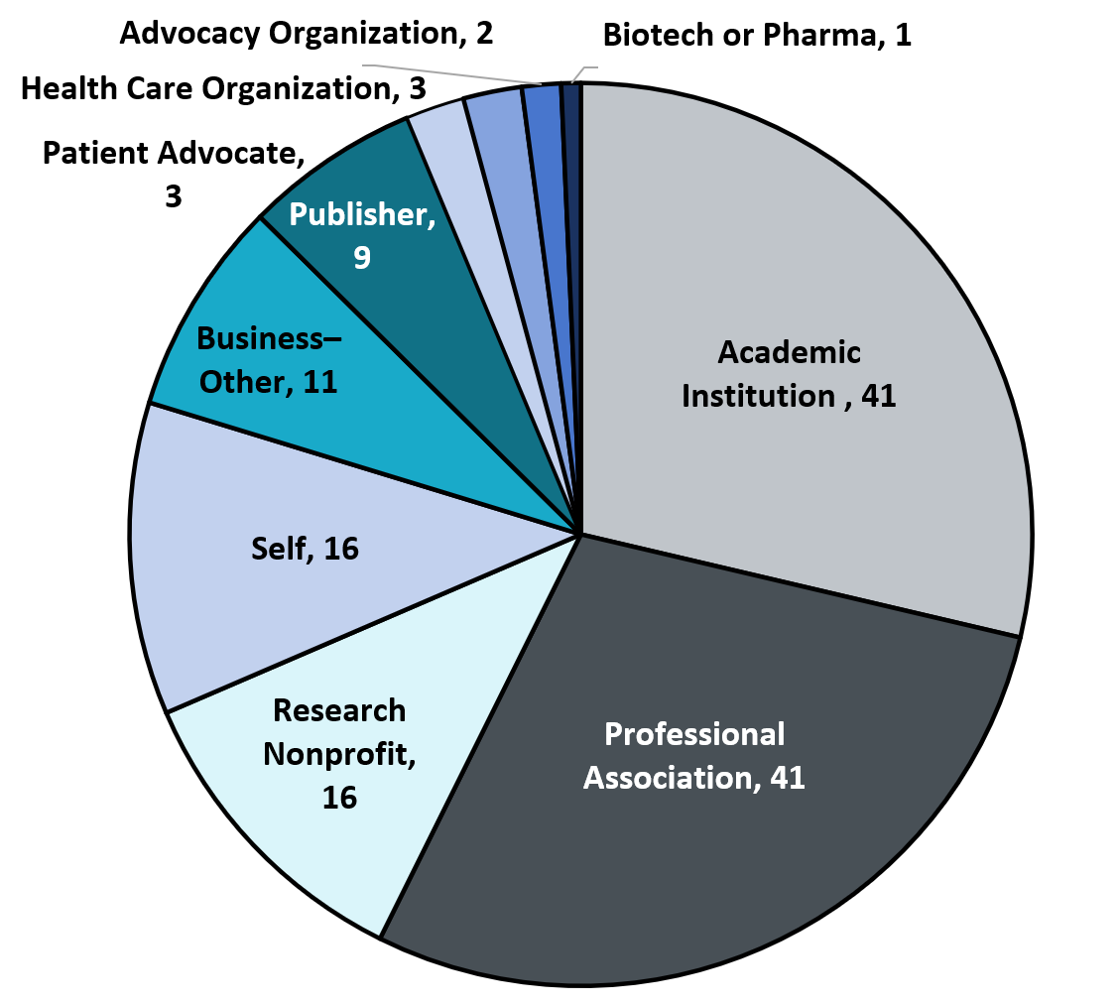
PRELIMINARY ANALYSES Feedback on Public Access Policy Proposal
Topics for feedback (RFI)
Improving equity in access and accessibility of publications
Ensuring equity in publication opportunities
Monitoring evolving costs and impacts
Increasing findability and transparency of research
Demographics of Respondents
Role within organization
Institutional Official: 50
Researcher: 40
Member of the Public: 30
Undesignated: 23

Slide 16
PRELIMINARY ANALYSES Feedback on Public Access Policy Proposal (cont.)
In general, respondents supported removing year embargo period
Current embargo window limits availability
Access further limited to the public who invested in the research
Many cautioned that “available” is not the same as “accessible” and NIH will need to implement additional strategies to support this goal
Publications can be difficult to find, more support for metadata, identifier use, and indexing of articles in PMC is needed
Inadequate communication of primary research to diverse audiences, including sensory impaired, multilingual audiences, and the public

Slide 17
Some Common Threads (what we have been working through and What we are hearing)

Slide 18
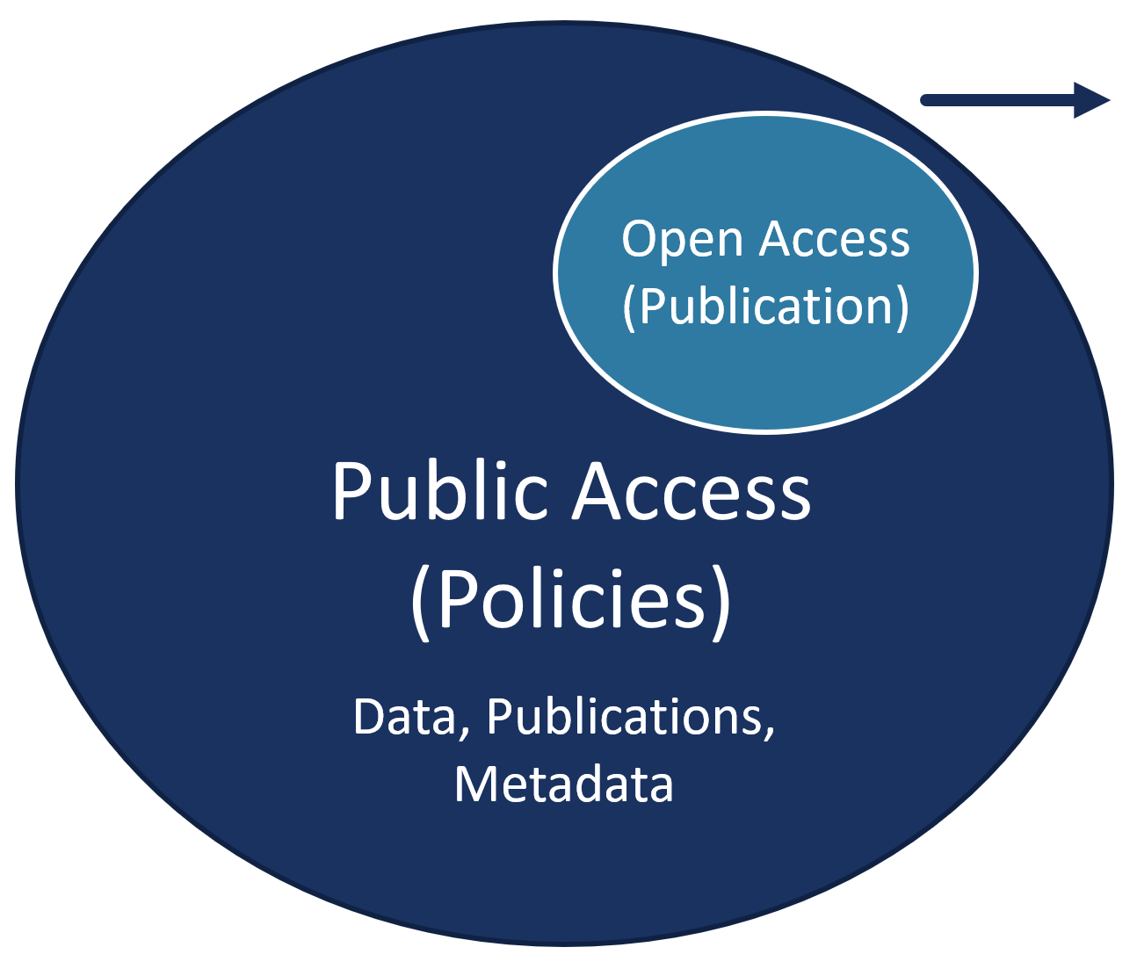
What we're Hearing/What We’re Working on Public access vs. Open Access
Public Access Policies
Free availability of federally funded scholarly materials to the public
Includes scientific data, publications, associated metadata
Open Access Publication
Publishing model for scholarly communication that makes research information available immediately to readers at no cost (publishers may charge authors to publish)
In contrast, traditional models give readers access to scholarly information through subscription (usually via libraries)

Slide 19
What we're Hearing/What We’re Working on Implications for Equity
! This is not an open access policy. NIH does not anticipate requiring a specific publication model as part of a revised NIH Public Access Policy
Concerns. Embargo removal will lead to drops in subscriptions; publishing costs shift to investigators via “article processing charges” (APCs)
Greater impact on those with fewer resources and without NIH funding
Diminished choice in where to publish
Proliferation in “predatory” journals

Slide 20
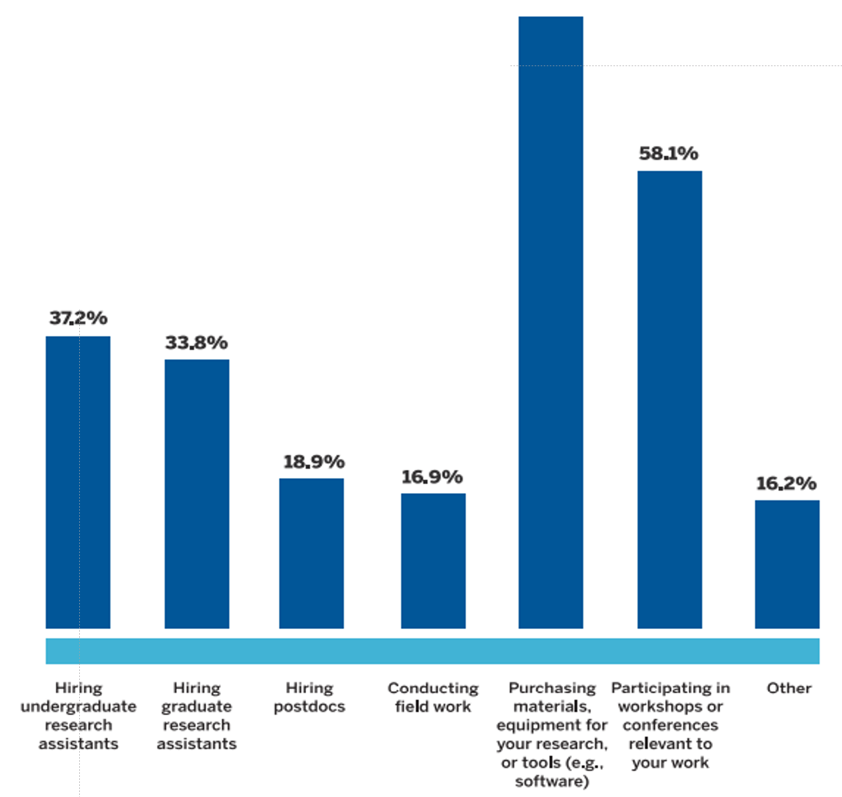
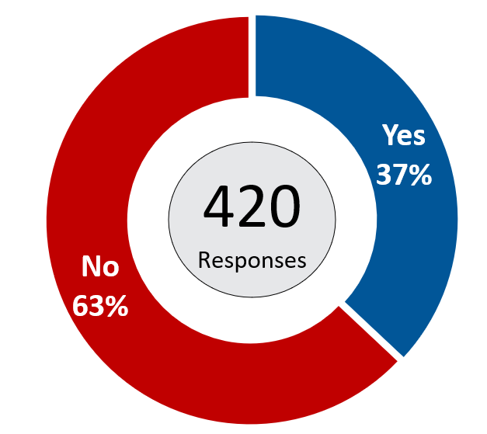
AAAS SURVEY ON SCHOLARLY PUBLICATION EXPERIENCES & PERSPECTIVES
_{KEY FINDINGS}
Most Researchers Do Not Currently Budget for Publishing Costs & Many Have Not Yet Paid APCs
Do you budget for costs associated _{with publishing your research?}
When paying to publish open access, have you had to use funds that you would have otherwise spent on any of the following?
77.7%
148 RESPONSES
AAAS.org

Slide 21
What we're Hearing/What We’re Working on Increase CLARITY AROUND PAYING TO PUBLISH
Some advocated for publishing business models in which authors don't have to pay APCs; we’ve heard from some publishers that APCs may be their path forward
Perception of some: Investigators will pay APCs from grant funding without commensurate increases in that funding and will have less money for research, community development, etc.
Commenters suggested NIH:
Continue requirements for authors to deposit their author-accepted (peer-reviewed) manuscript in PubMed Central (meets compliance expectations at no cost)
Pay more for the costs of open access publication (several models suggested)
Work with publishers to clarify "reasonable" costs and share that information with the public
Consider the impact of these changes on publications of research that is not NIH-supported

Slide 22
What we're Hearing/What We’re Working on monitor publication costs
Define what constitutes “reasonable” costs
Potential approaches floated
Look at application budgets and annual reports
Work with publishers to understand publishing model and/or discipline specific requirements
Reference currently existing resources (e.g. Journal Comparison Service)
NIH should also monitor equity issues associated with publication costs!

Slide 23
What we're Hearing/What We’re Working on EASE administrative burden
Clarify and ease mechanisms for compliance:
Concise guidance for depositing manuscripts and/or articles
Resources to ensure requirements are met (e.g. template language for licensing and rights retention)
Coordinating across federal agencies
White House led interagency groups
Externally-driven stakeholder meetings to create incentives

Slide 24
going forward policy development/implementation timeline
2003 Data Sharing Policy
2008 Public Access Policy
2015 Genomic Data Sharing Policy
2017 Clinical Trial Policy
Jan 23, 2023 Data Management & Sharing (DMS) Policy Effective
On or by Dec 31, 2027 Revised Public Access Policy Effective
On or by Dec 31, 2027 Persistent Identifiers Policy Effective
A DRAFT POLICY WILL BE RELEASED FOR PUBLIC COMMENT!
PLAN IS TO HAVE A DELAY BETWEEN POLICY RELEASE AND EFFECTIVE DATE!

Slide 25
Questions for discussion with ACD
NIH has been working across the USG and with the community to grapple with implementation challenges and will continue to do so. NIH recognizes the need for a coordinated effort at all levels.
For the ACD, some big picture questions still need to be addressed to achieve these policy aims:
Given that NIH is the world’s largest public funder of biomedical research, what roles and responsibilities do awardees have in making research results available to the public immediately and free of cost?
What future opportunities and challenges do you see for public access to research products?
Though the USG is developing these policies, what incentives are needed to achieve policy aims and who should provide these incentives?

Slide 26
Stay in touch with the office of science policy

