Slide 1
The 21st Century Cures Act
Regenerative Medicine Innovation Project (RMIP)
Robert H. Carter, M.D.
Deputy Director, NIAMS
Advisory Committee to the Director
June 8, 2023

Slide 2
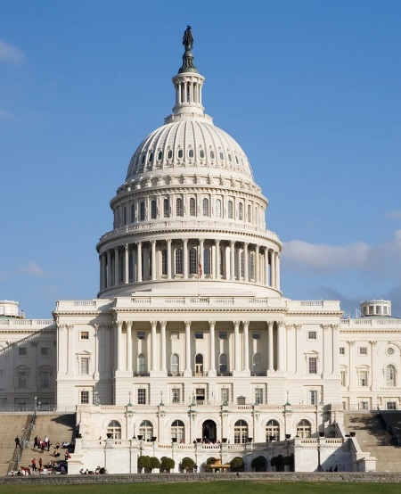
21st Century Cures Act: Regenerative Medicine (RM) Provisions
Applicable to NIH, FDA, and NIST and aimed at:
Accelerating progress
Promoting scientific rigor
Applying appropriate regulatory oversight and standards
Stimulating innovation and partnership
Established RM Innovation Project (RMIP)
NIH, working in coordination with FDA, to support research to advance the field of regenerative medicine using adult stem cells
$30M authorized 2017-2020; with 1:1 matching, supports $60M in project costs

Slide 3
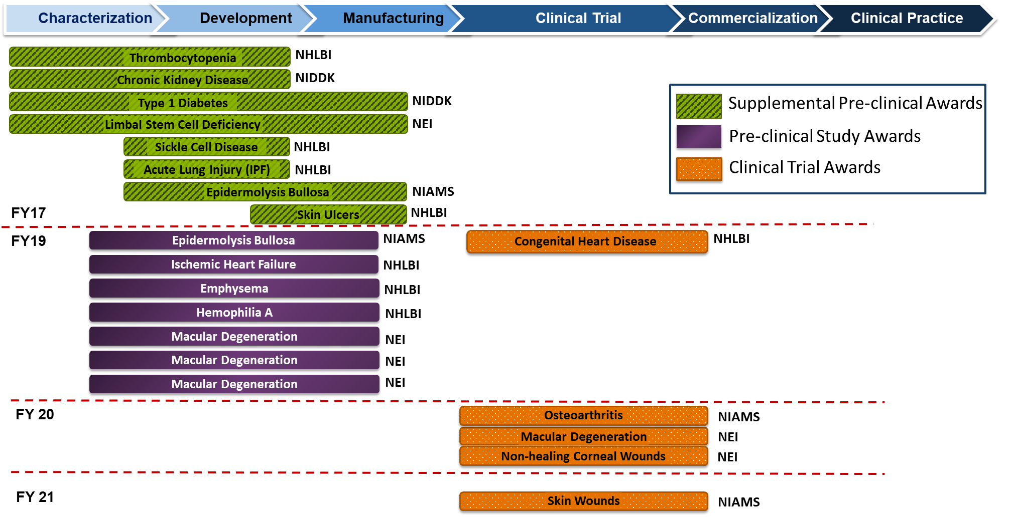
RMIP Grant Portfolio Overview
RM-Specific Product Development Pathway

Slide 4
RMIP Obligated Funds (FY17 – FY21)
~$10.3 M Remaining for FY 22 and Beyond

Slide 5
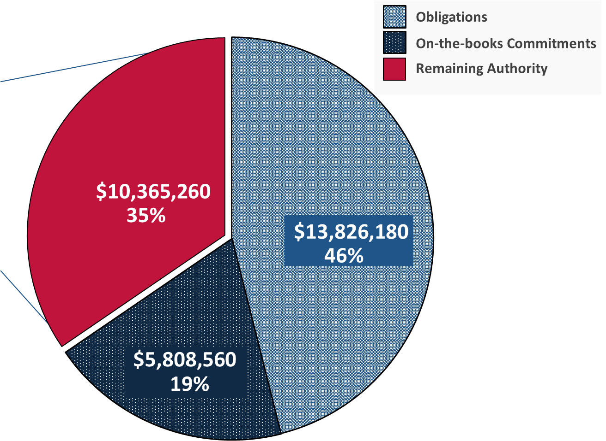
RMIP: Available Funds
Budgeted for FY23 RMIP Applications $8,000,000
Budgeted for IDCC (Georgia Tech) *
$2,365,260

Slide 6
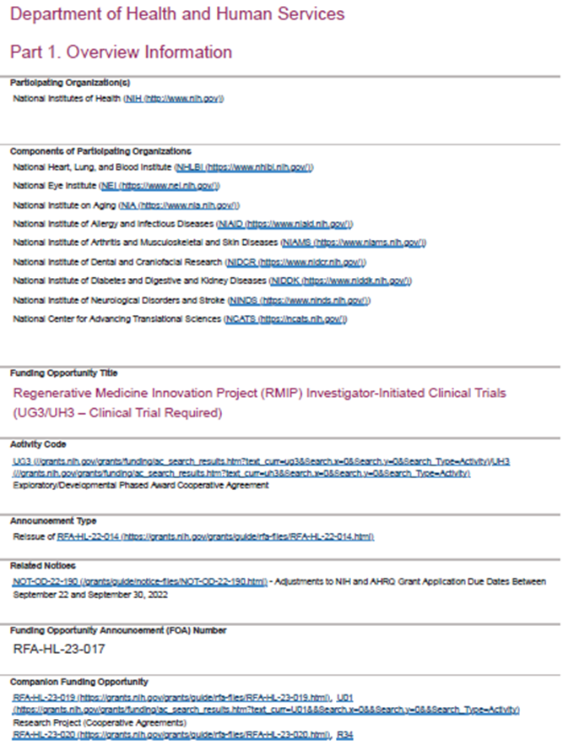
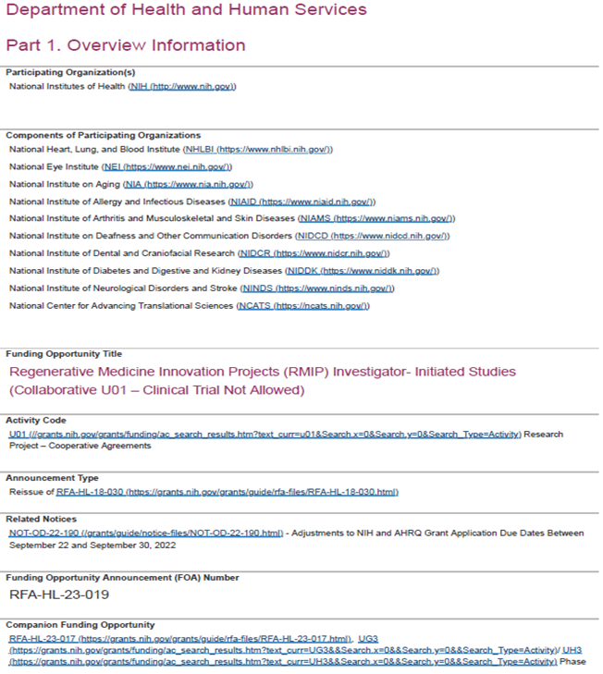
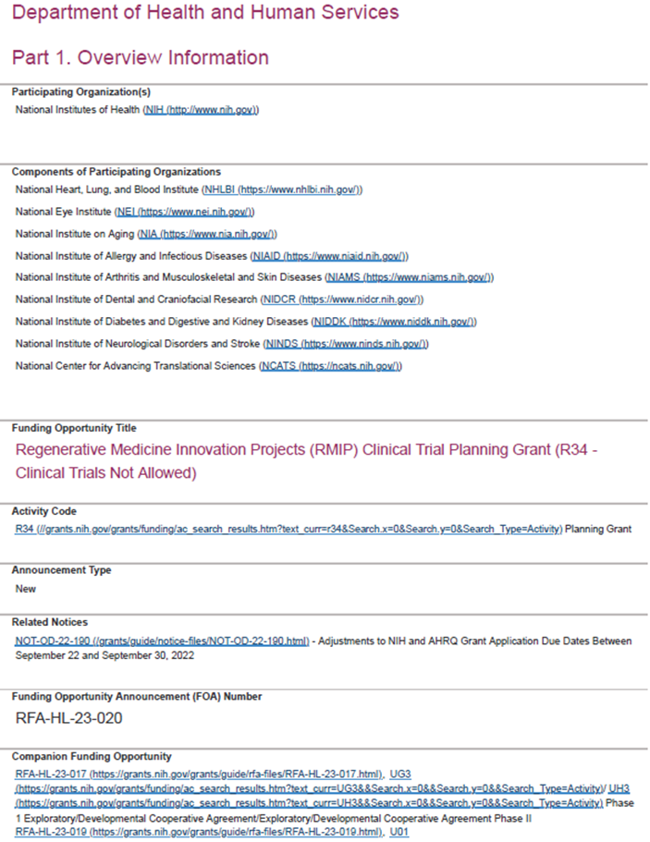
Current RMIP Funding Opportunities
RFA-HL-23-017: UG3/UH3 FOA to solicit applications to fund clinical trials
RFA-HL-23-019: U01 FOA to solicit applications for IND-enabling preclinical studies
RFA-HL-23-020: NIH Clinical Trial Planning Grant Program (R34) to provide support for the initial development of RMIP clinical trials or research projects
Publication Date (all): July 7, 2022

Slide 7
RMIP UG3/UH3 (Clinical Trial) IC Enthusiasm
Type | Actv | Project | Title | PI Name(s) All | IC | Score | Req Tot Yr 1 | Req Tot (project)
1 | UG3 | AR082887-01 | Study of the Safety, Tolerability, and Efficacy of an iPS Cell-based Therapy for Recessive Dystrophic Epidermolysis Bullosa Delivered with a Spray on Skin Device | ROOP, DENNIS (contact); BRUCKNER, ANNA LEE | AR | 33 | $536,475 | $2,682,375
1 | UG3 | AR082888-01 | Regenerative Engineering of Osteoarthritic Joints Using Stem Cell Delivery System | LAURENCIN, CATO T | AR | 42 | $520,281 | $2,607,673
1 | UG3 | DK136705-01 | Safety and Efficacy of Mesenchymal Stem Cells in the Treatment of Chronic Pancreatitis and Its Associated Pain | WANG, HONGJUN | DK | 42 | $337,938 | $2,017,867
1 | UG3 | AG082883-01 | Lomecel-B for Alzheimers disease: A Phase 2 Clinical Trial on the Safety and Effects of Regenerative Medicine Geroscience Therapeutic Candidate | OLIVA, ANTHONY ANDREW (contact); RAMDAS, KEVIN NARAIN | AG | 44 | $662,400 | $3,312,000
1 | UG3 | DK136548-01 | Mesenchymal Stem Cell Therapy for Diabetic Kidney Disease: An Early Phase Clinical Trial | HICKSON, LATONYA J | DK | 50 | $891,126 | $2,778,787

Slide 8
RMIP U01 (Preclinical Studies) IC Enthusiasm
Type | Actv | Project | Title | PI Name(s) All | IC | Score | Req Tot Yr 1 | Req Tot (project)
1 | U01 | HL169362-01 | Full-scale GMP Production for a Pre-Clinical Systemic Delivered Mesenchymal Stem Cells Derived Extracellular Vesicles For Cardiovascular Disease | HARE, JOSHUA M (contact); KHAN, AISHA | HL | 28 | $288,744 | $502,236
1 | U01 | HL169361-01 | Nanowired human isogenic cardiac organoids to treat acute myocardial ischemia/reperfusion injuries | MEI, YING | HL | 35 | $379,889 | $745,982
1 | U01 | EY035252-01 | Cell Therapy Program with Scale-up cGMP Manufacturing of Human Corneal Stromal Stem Cells | YAM, HIN FAI (contact); HSU, YEN-MICHAEL S | EY | 43 | $534,428 | $1,050,156
1 | U01 | AR082845-01 | Development and Translation of Granulated Human-Derived Biomaterials for Integrative Cartilage Repair | NEU, COREY P | AR | 44 | $358,875 | $703,625
1 | U01 | HL169363-01 | Therapeutic efficacy of iPSC-derived cardiomyocytes expressing growth hormone releasing hormone receptor for myocardial infarction | HARE, JOSHUA M | HL | 48 | $383,749 | $767,499
1 | U01 | DE033027-01 | Personalized stem cell-based therapy by regenerative suture with guided cranial bone ossification | HSU, WEI (contact); SUN, JIRUN | DE | 48 | $497,500 | $995,000

Slide 9
RMIP R34 (CT Planning Grant) IC Enthusiasm
Type | Actv | Project | Title | PI Name(s) All | IC | Score | Req Tot Yr 1 | Req Tot (project)
1 | R34 | NS133062-01 | Autologous adipose derived MSCs for chronic traumatic brain injury | COX, CHARLES S | NS | 37 | $247,415 | $247,415
1 | R34 | DE033042-01 | Planning a phase I study of minor salivary gland derived autologous MSCs for prevention of long-term radiation induced xerostomia | KIMPLE, RANDALL J (contact); MCCOY, SARA | DE | 45 | $150,000 | $300,000

Slide 10
Recommended Funding Plan, Total Requested Costs: $8.0M
Type | Actv | Project | Title | PI Name(s) All | IC | Score | Req Tot Yr 1 | Req Tot (project)
1 | UG3 | AR082887-01 | Study of the Safety, Tolerability, and Efficacy of an iPS Cell-based Therapy for Recessive Dystrophic Epidermolysis Bullosa Delivered with a Spray on Skin Device | ROOP, DENNIS (contact); BRUCKNER, ANNA LEE | AR | 33 | $536,475 | $2,682,375
1 | UG3 | DK136705-01 | Safety and Efficacy of Mesenchymal Stem Cells in the Treatment of Chronic Pancreatitis and Its Associated Pain | WANG, HONGJUN | DK | 42 | $337,938 | $2,017,867
1 | U01 | HL169362-01 | Full-scale GMP Production for a Pre-Clinical Systemic Delivered Mesenchymal Stem Cells Derived Extracellular Vesicles For Cardiovascular Disease | HARE, JOSHUA M (contact); KHAN, AISHA | HL | 28 | $288,744 | $502,236
1 | U01 | HL169361-01 | Nanowired human isogenic cardiac organoids to treat acute myocardial ischemia/reperfusion injuries | MEI, YING | HL | 35 | $379,889 | $745,982
1 | U01 | EY035252-01 | Cell Therapy Program with Scale-up cGMP Manufacturing of Human Corneal Stromal Stem Cells | YAM, HIN FAI (contact); HSU, YEN-MICHAEL S | EY | 43 | $534,428 | $1,050,156
1 | U01 | AR082845-01 | Development and Translation of Granulated Human-Derived Biomaterials for Integrative Cartilage Repair | NEU, COREY P | AR | 44 | $358,875 | $703,625
1 | R34 | DE033042-01 | Planning a phase I study of minor salivary gland derived autologous MSCs for prevention of long-term radiation induced xerostomia | KIMPLE, RANDALL J (contact); MCCOY, SARA | DE | 45 | $150,000 | $300,000

Slide 11
Justifications for Medium Enthusiasm Applications
1U01EY035252-01: Cell Therapy Program with Scale-up cGMP Manufacturing of Human Corneal Stromal Stem Cells
This therapeutic strategy holds promise could be apply to a variety of injury types beyond what is current being studied.
Data will be used to inform large animal studies (next step beyond this application) but also will be essential for IND application.
1U01AR082845-01: Development and Translation of Granulated Human-Derived Biomaterials for Integrative Cartilage Repair
Preliminary data show impressive repair although PI recognizes further optimization will be needed to promote increased cellular infiltration and healthy cartilage regeneration. This application will help move them in that direction.
Partnership with company and FDA regulatory expertise on team suggest a feasible pathway towards an IDE.
1R34DE033042-01: Planning a phase I study of minor salivary gland derived autologous MSCs for prevention of long-term radiation induced xerostomia
Current management for this condition is supportive care, clear need for a regenerative approach.
The PI and study team are well experienced with obtaining INDs and trials using MSCs including having a current phase I trial using bone marrow derived MSCs supported by NIDCR.
PI has been able to convince program staff that the minor salivary glands are a viable source of MSCs, which was a major concern during review.

Slide 12
Thank you!

