Slide 1
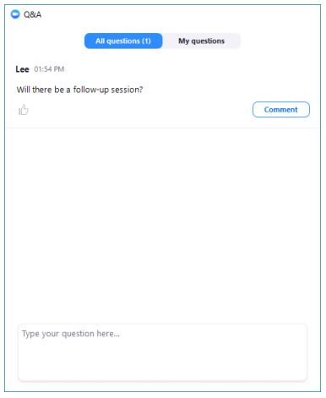
Postdoc Listening Sessions: Housekeeping
The listening session will include opening remarks, introductions, and remarks from invited speakers, followed by a facilitated discussion for the remainder of the session, inviting all attendees to share input
Attendees will be muted at the beginning of the session
To share your input: please use the Q&A function to share your comments with the facilitators
Facilitators will call on specific attendees to speak. If called upon, the host will enable you to unmute. Please state your name before sharing input
If you prefer to contribute anonymously, please share your comment using the anonymous option, and a facilitator will read it without attribution
Please communicate through the Q&A function if you are experiencing technical difficulties
Time: we will be keeping time; each commenter will have 1-2 minutes to share

Slide 2
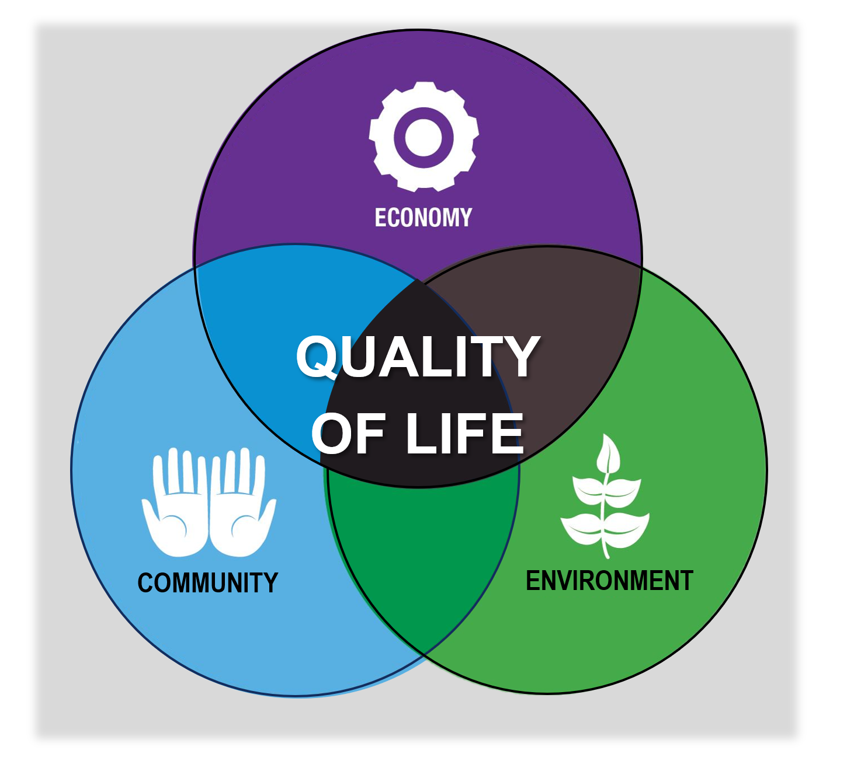
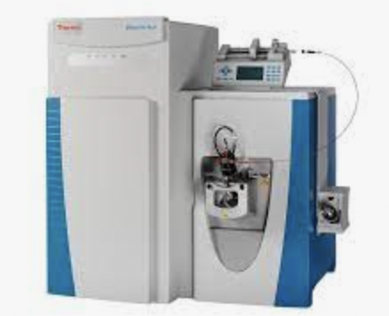
Forces driving decline in postdocs are multifactorial and complex
Limited opportunities in academia
Lengthening time to publish
Increasing expectations: Work/life balance Cost of living
Expanding research expectations
New opportunities in Pharma/Biotech

Slide 3
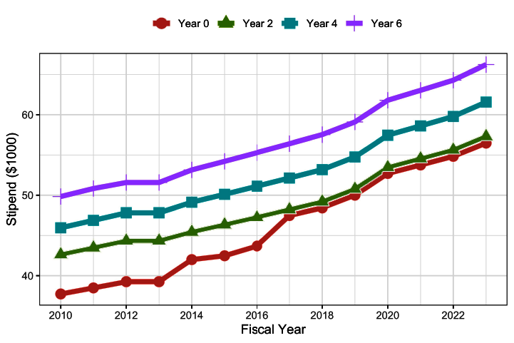
NSF NRSA postdoctoral stipends have increased over time
Stipend Level, 2010 – 2023
Source: NIH/OER

Slide 4
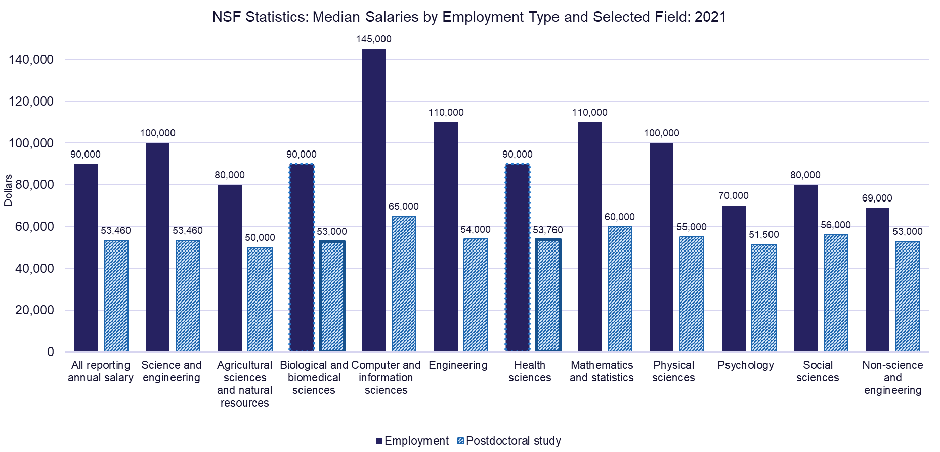
Median starting salaries in employment exceed postdoctoral stipends
NSF Statistics: Median Salaries by Employment Type and Selected Field: 2021
Source: NSF Survey of Earned Doctorates

Slide 5
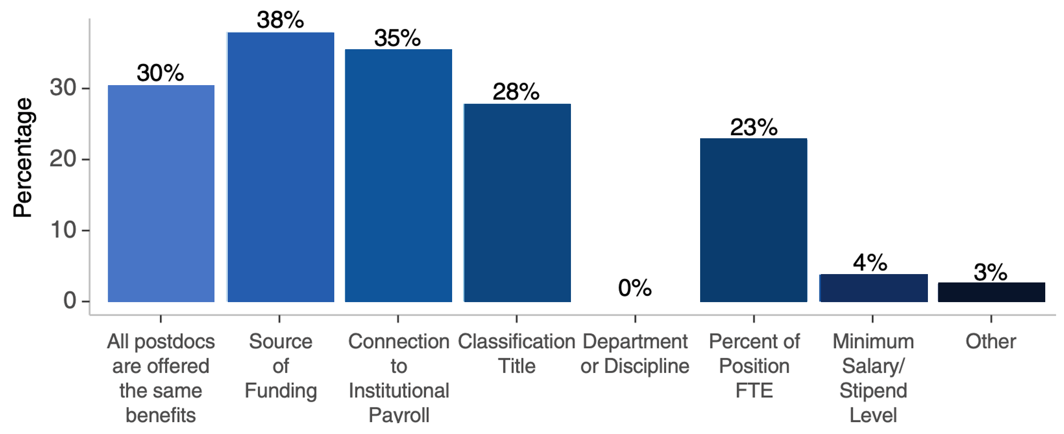
Institutional variability in benefits coverage
If the same benefits are not offered to all postdocs, which of the following criteria impacts benefits eligibility?
Source: 2021 National Postdoctoral Association Institutional Policy Report

Slide 6
Today’s listening session: Compensation and benefits
Increasing expectations:
Cost of living

